Slide 1
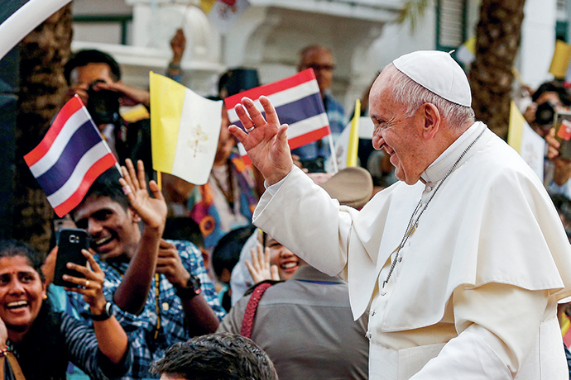

Slide 2
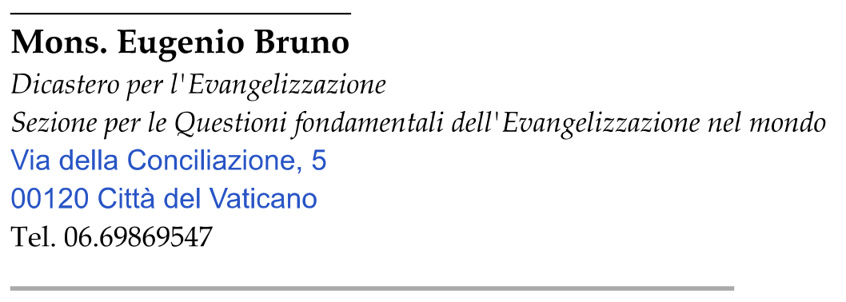
Meeting of Catechetical Leaders
of the Episcopal Conferences of Asia
Pope Pius XII Catholic Center, Manila
11-12 February 2026

Slide 3
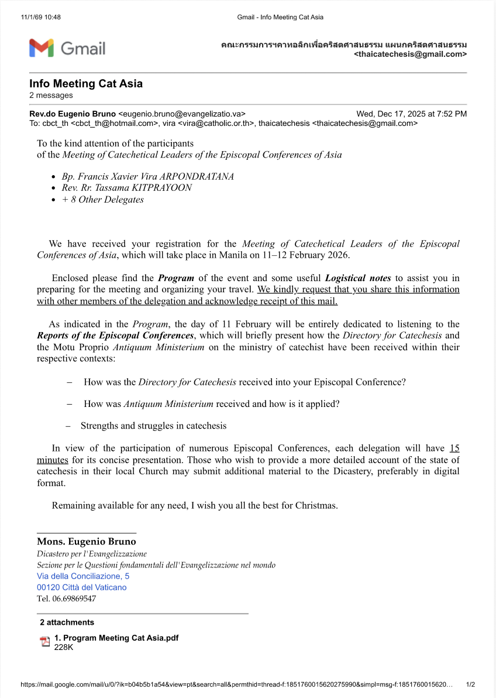

Slide 4
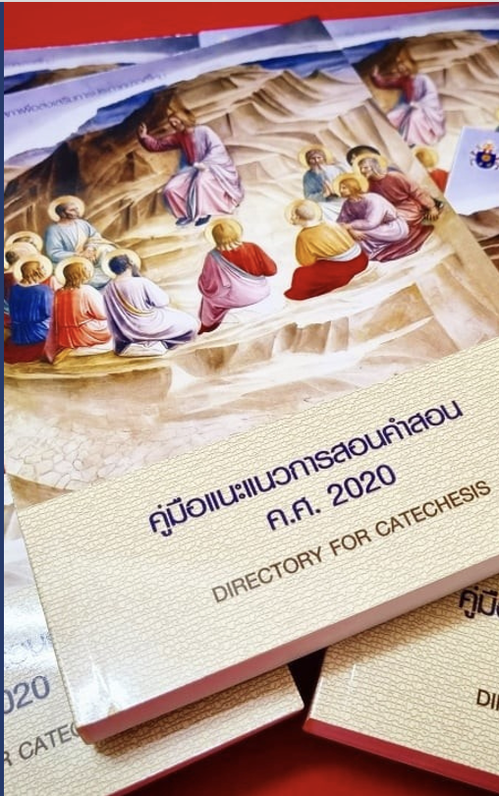

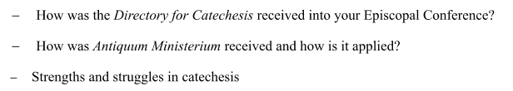

Slide 5
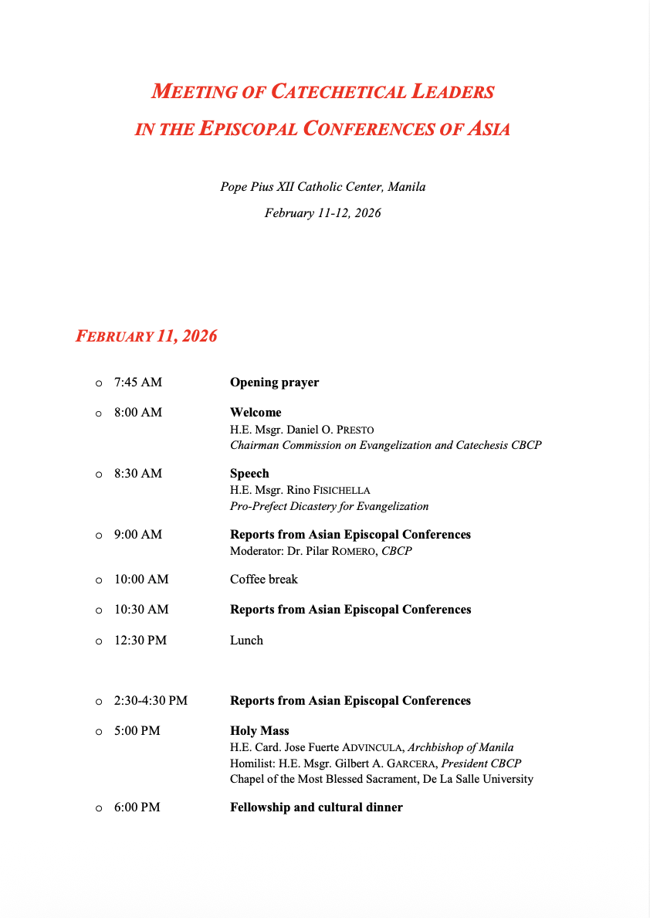
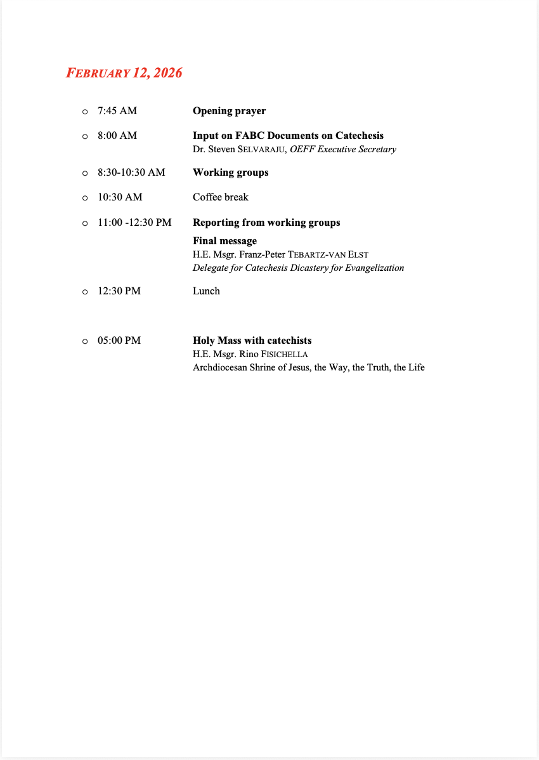

Slide 6
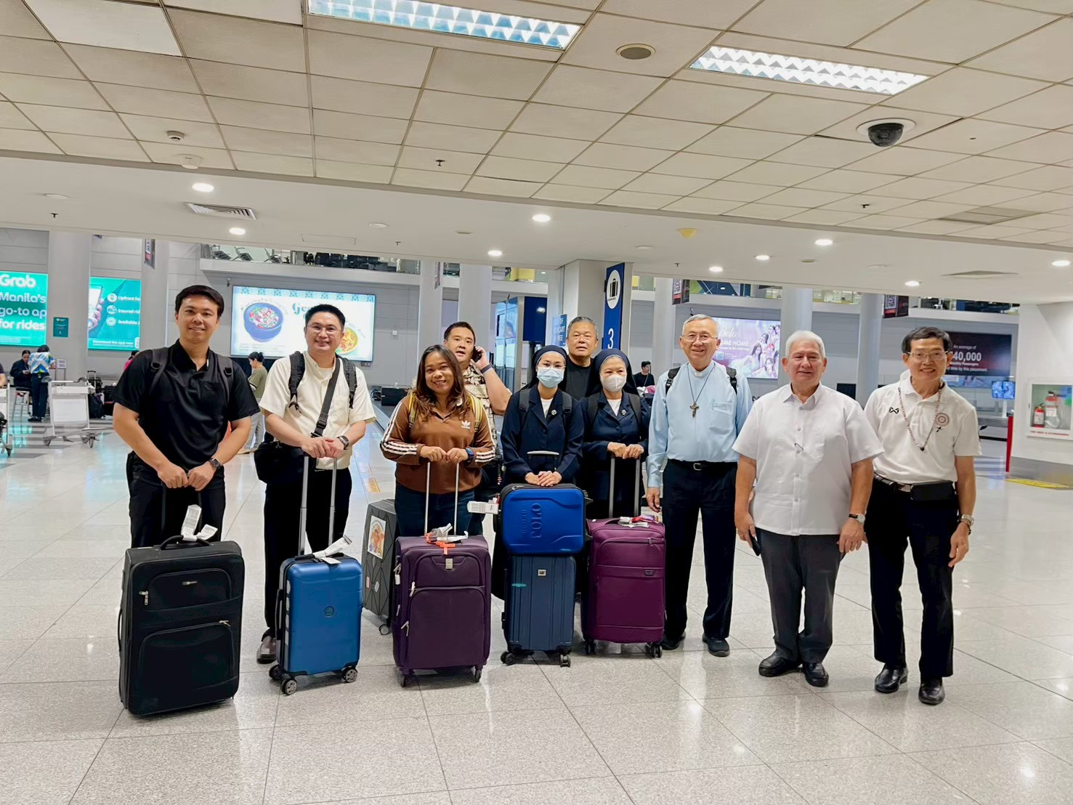

Slide 7
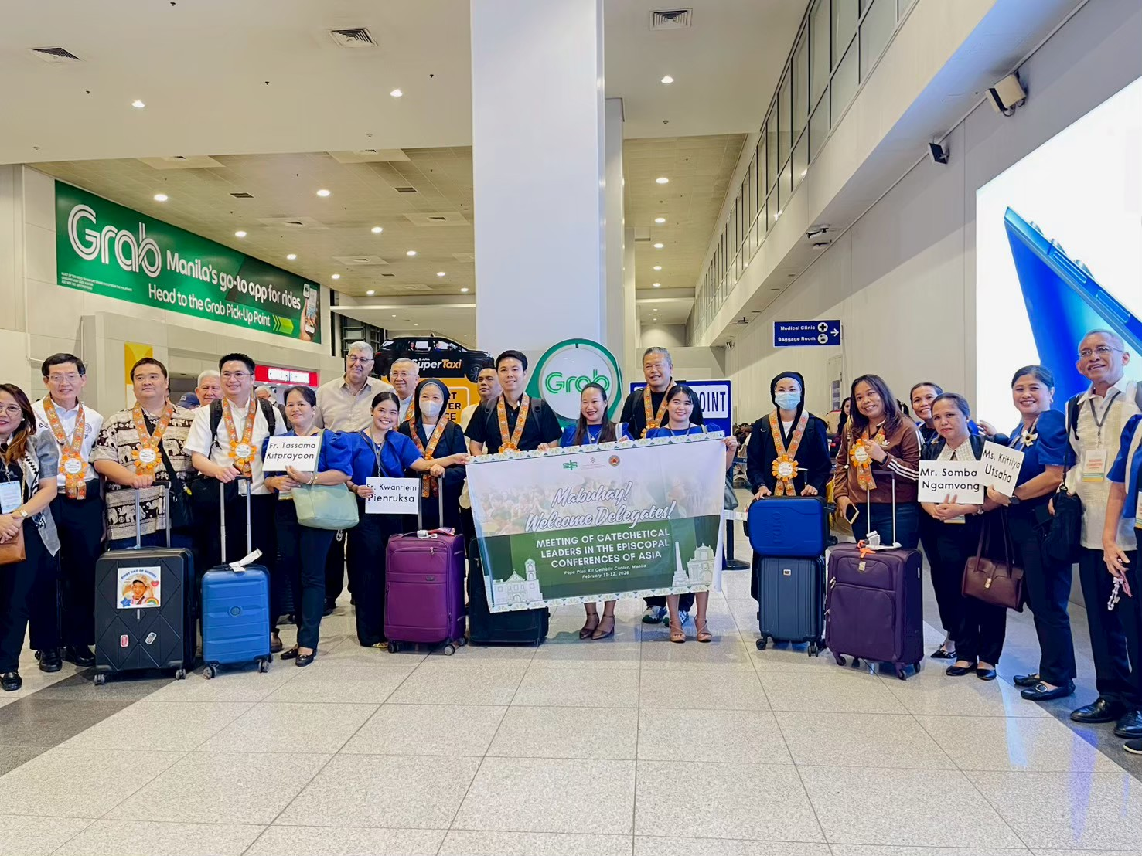

Slide 8
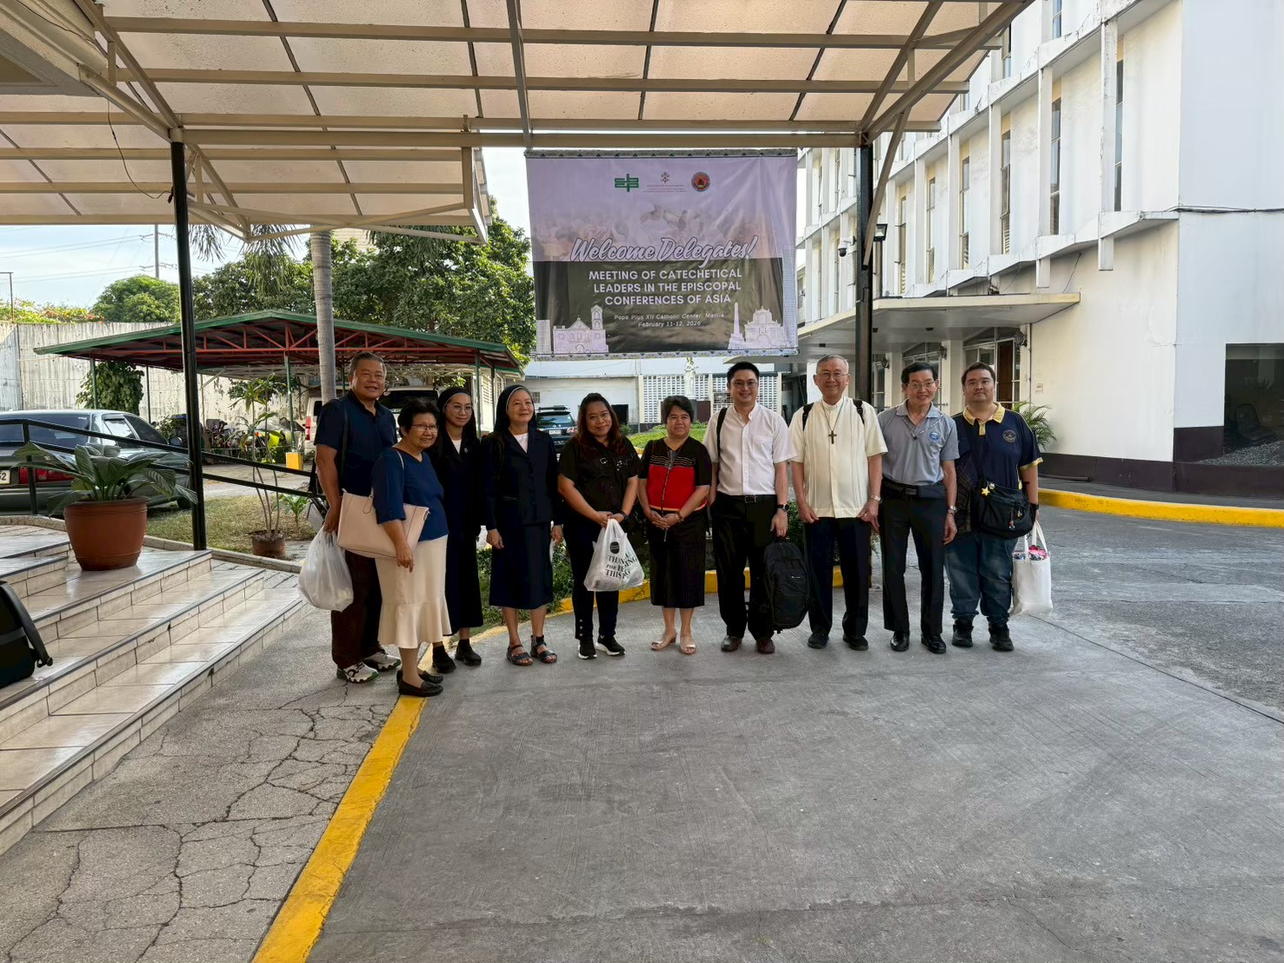

Slide 9
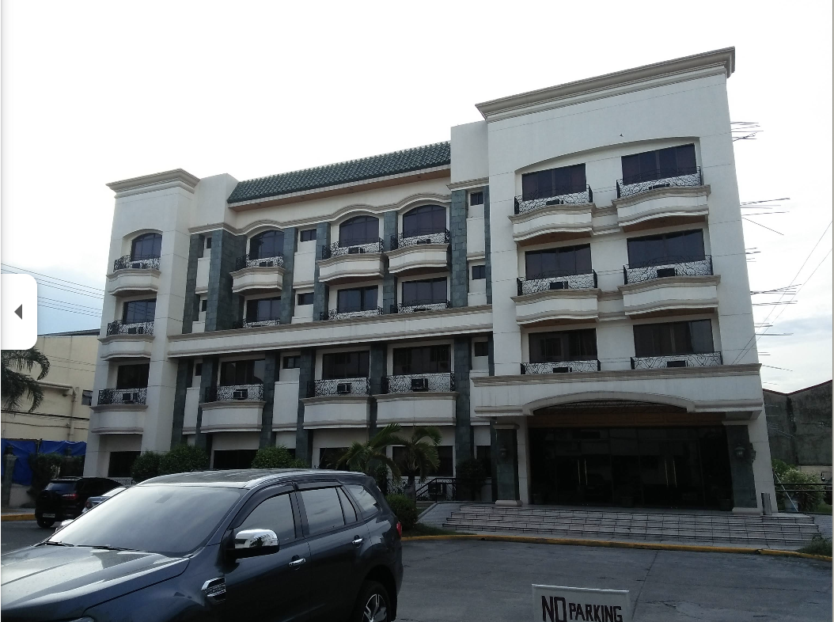

Slide 10
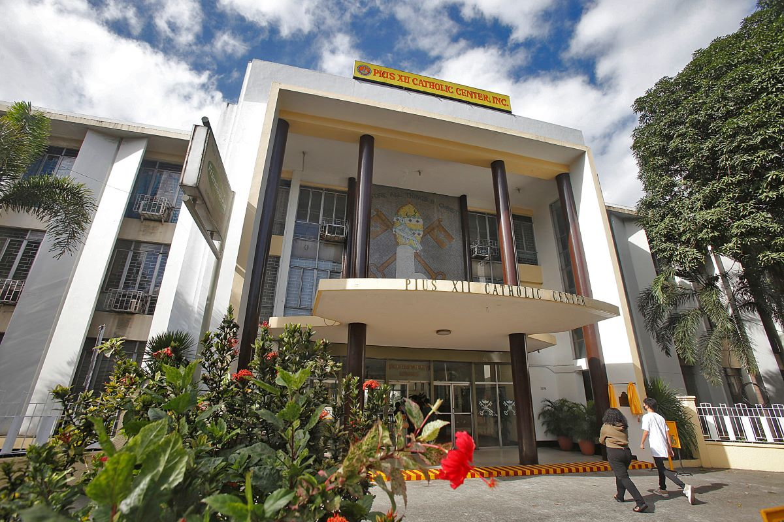

Slide 11
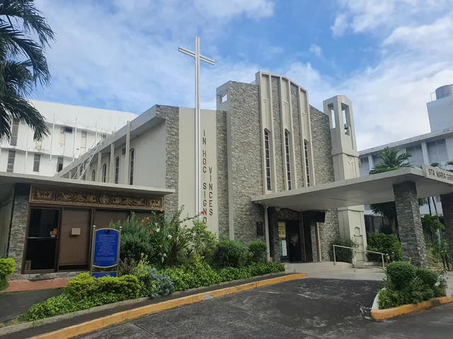

Slide 12
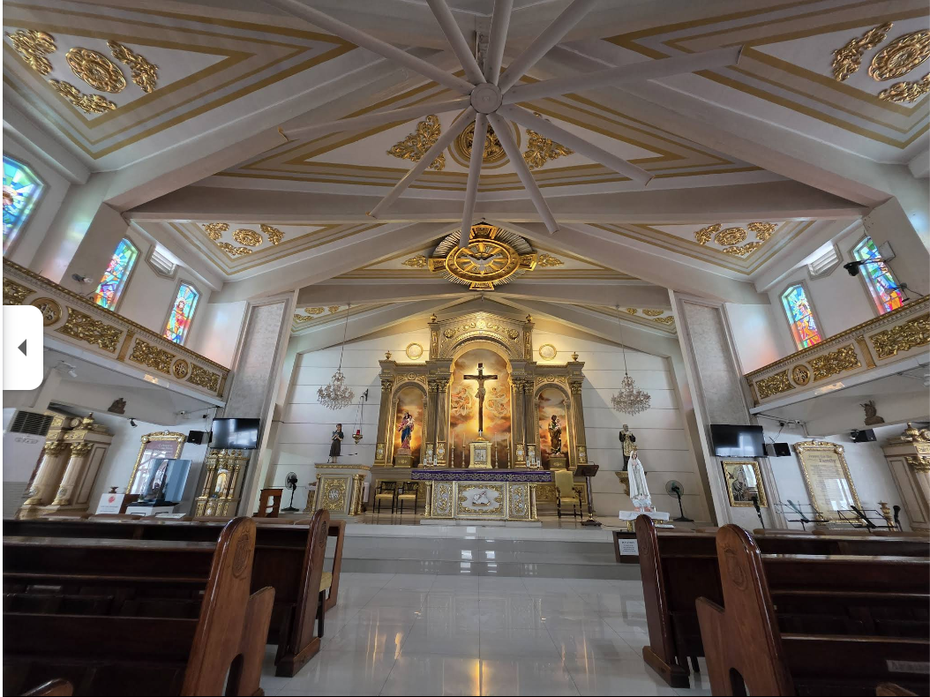

Slide 13
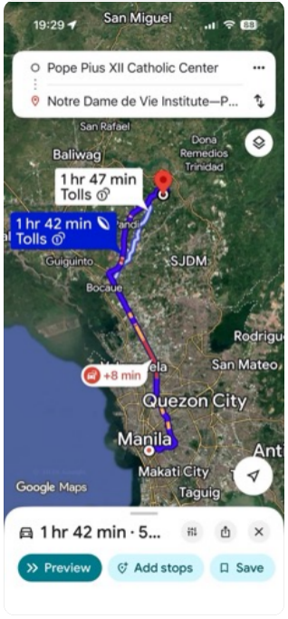
บ้านผู้สูงอายุ Notre Dame de Vie Community Center in Bulacan
Notre Dame de Vie Institute เป็นสถาบันนักบวชฆราวาส (Secular Institute) ก่อตั้งขึ้นในฝรั่งเศส มีบ้านที่ฟิลิปปินส์

Slide 14
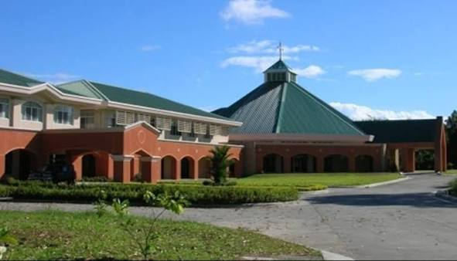

Slide 15
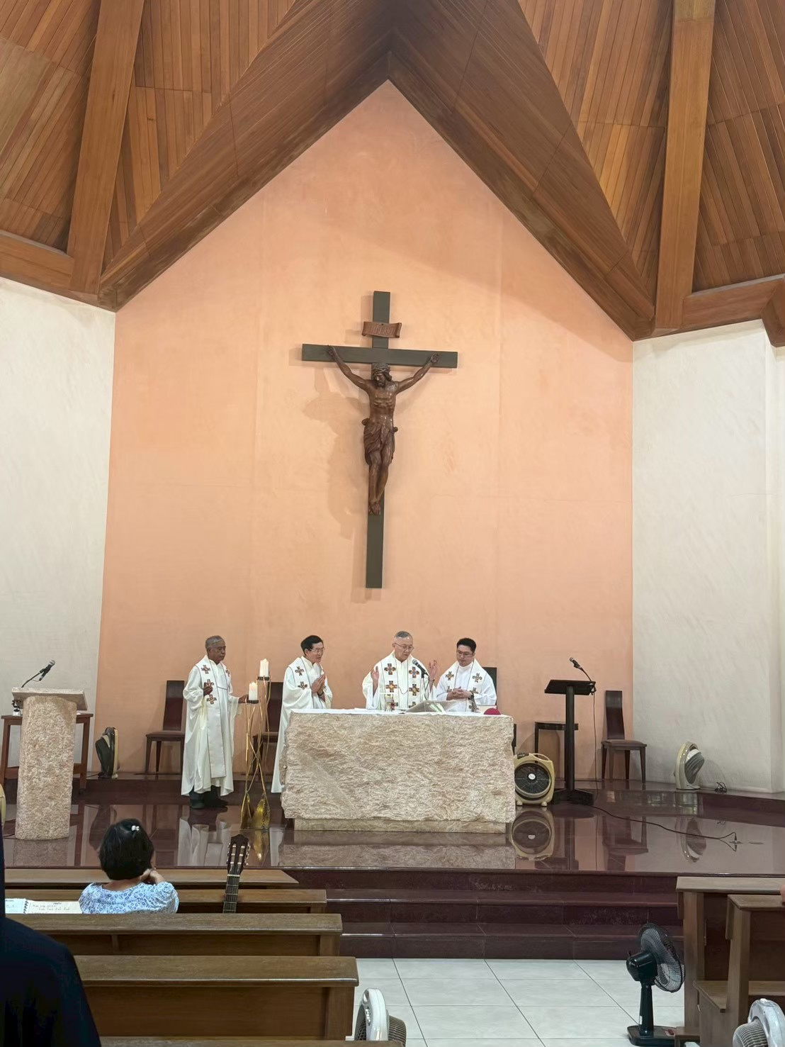

Slide 16
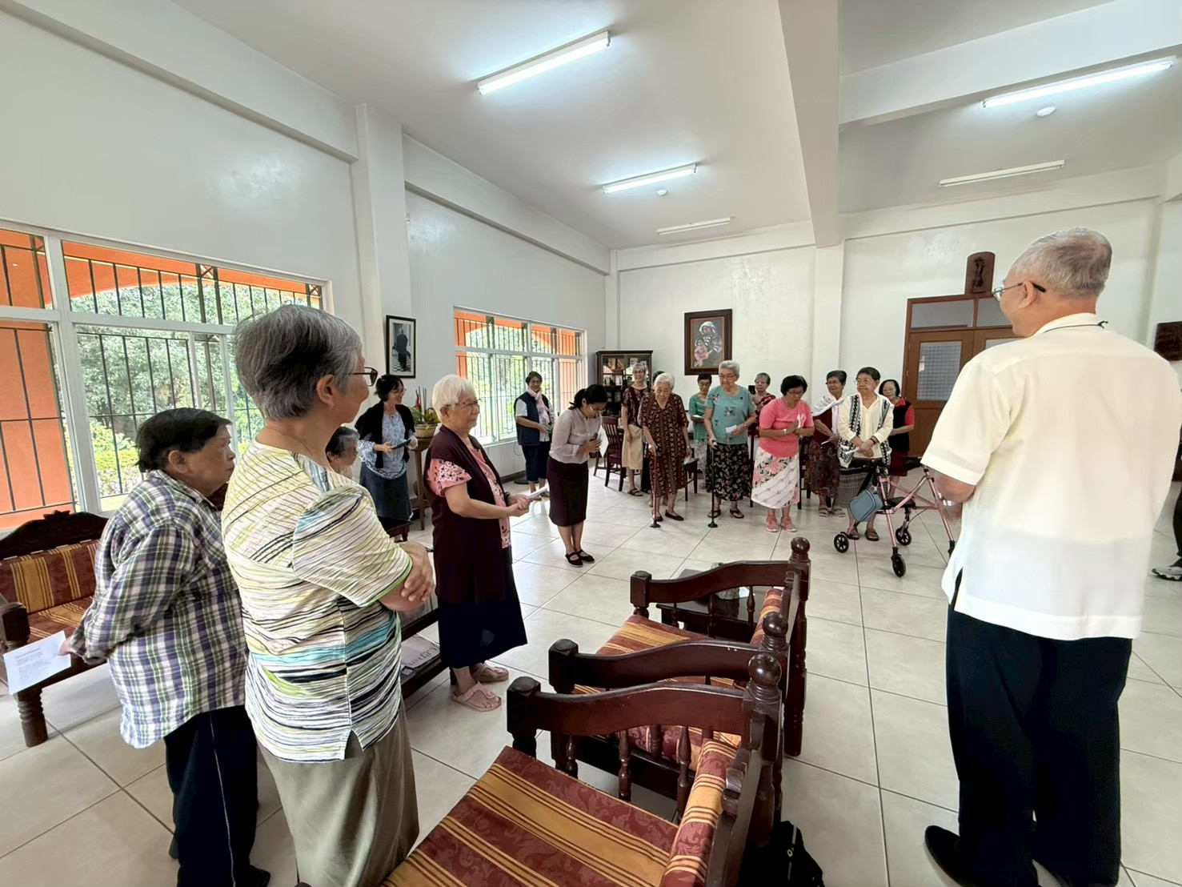

Slide 17
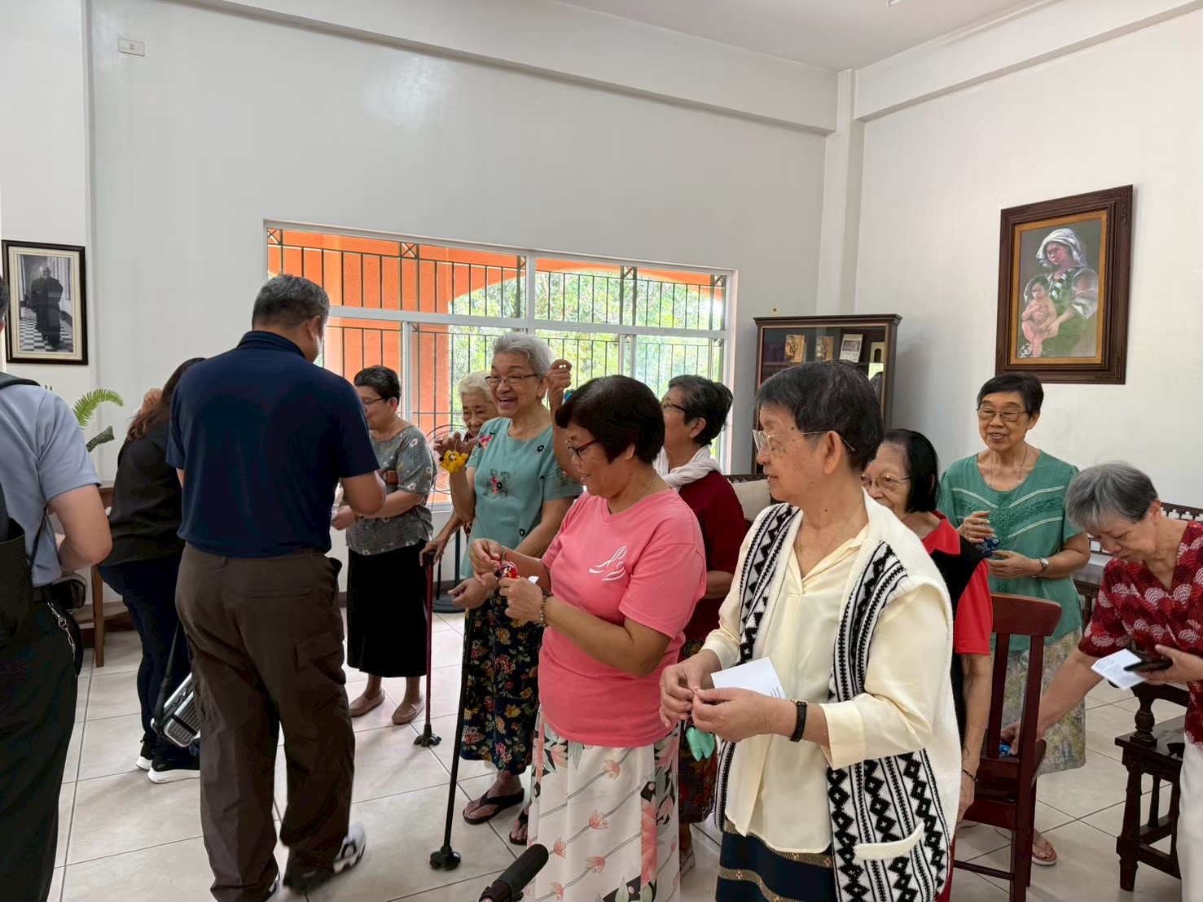

Slide 18
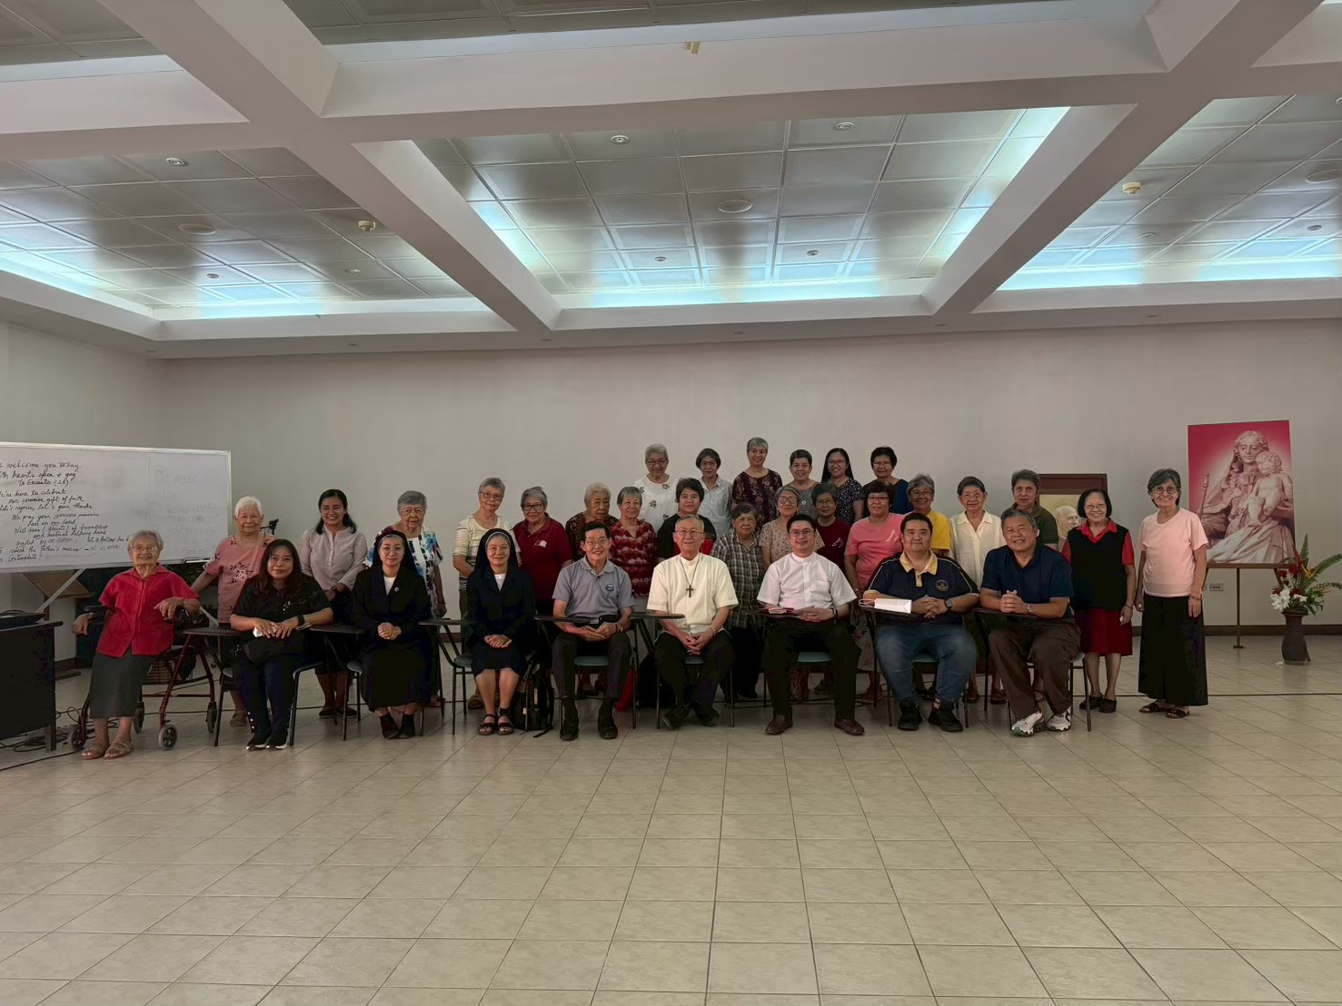

Slide 19
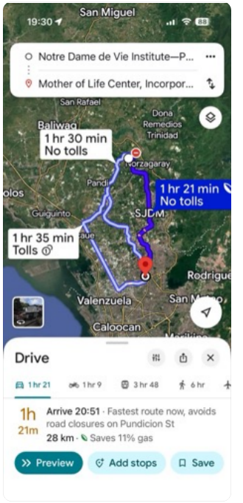
Mother of Life Center in Novaliches, Quezon City
ศูนย์อบรมครูคำสอน
บ้านเข้าเงียบ

Slide 20
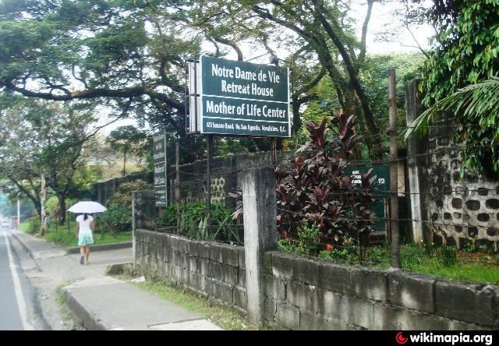

Slide 21
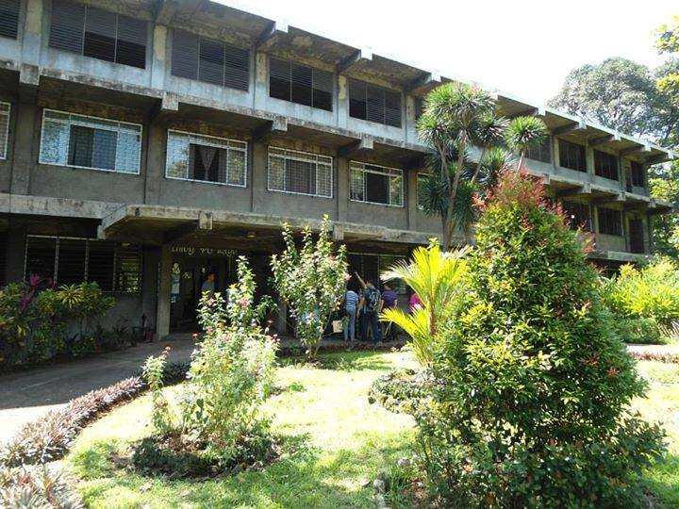

Slide 22
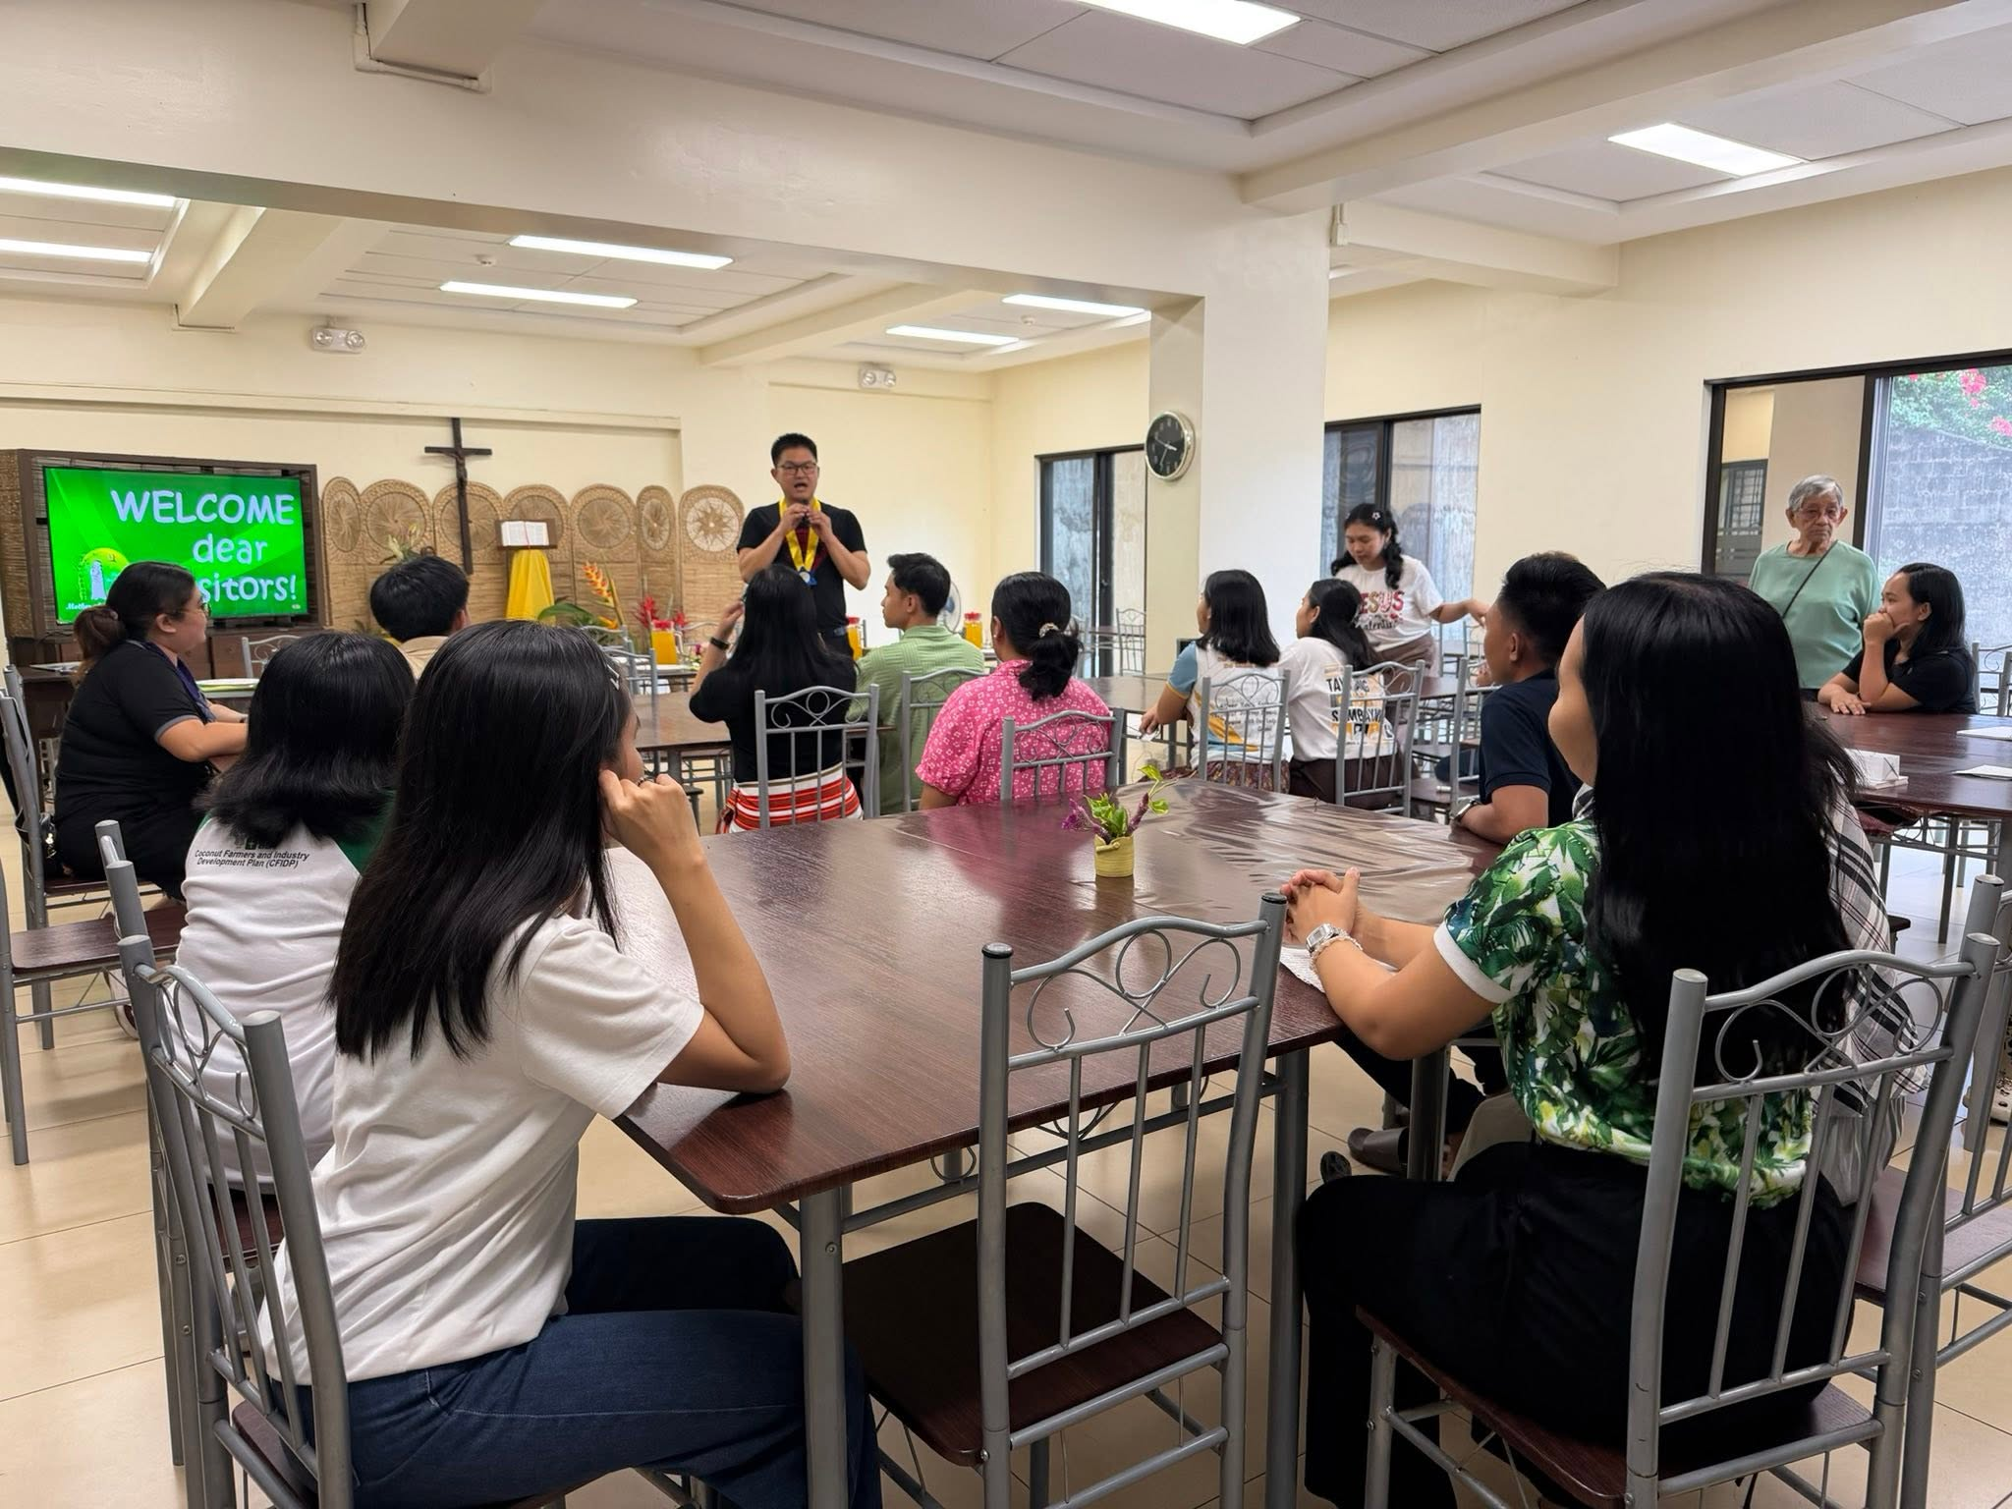

Slide 23
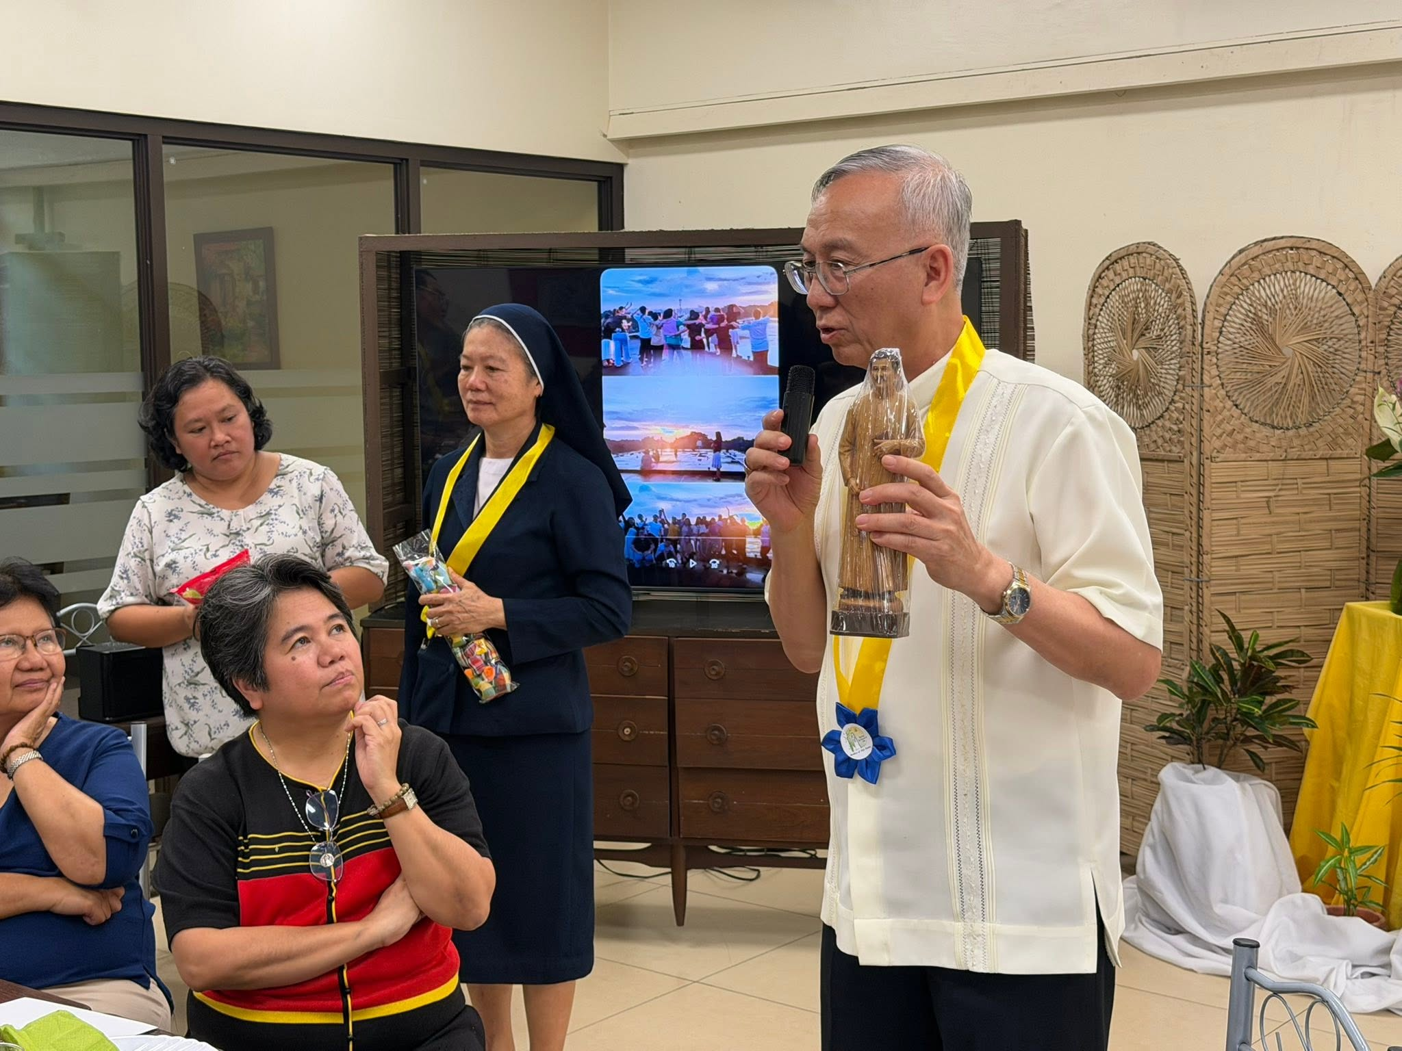

Slide 24
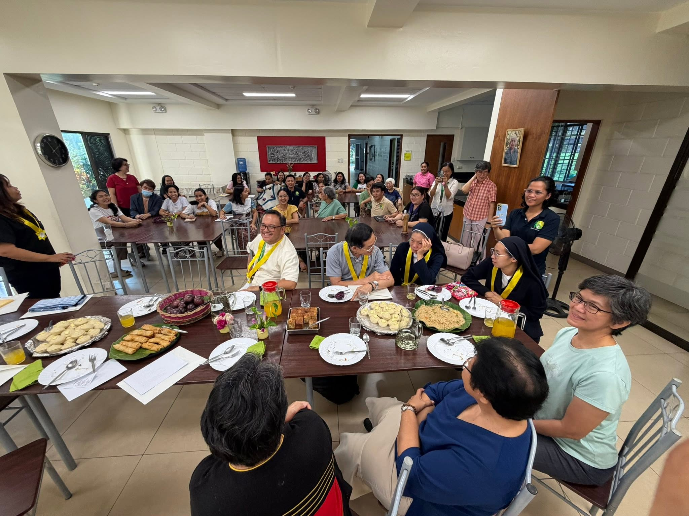

Slide 25
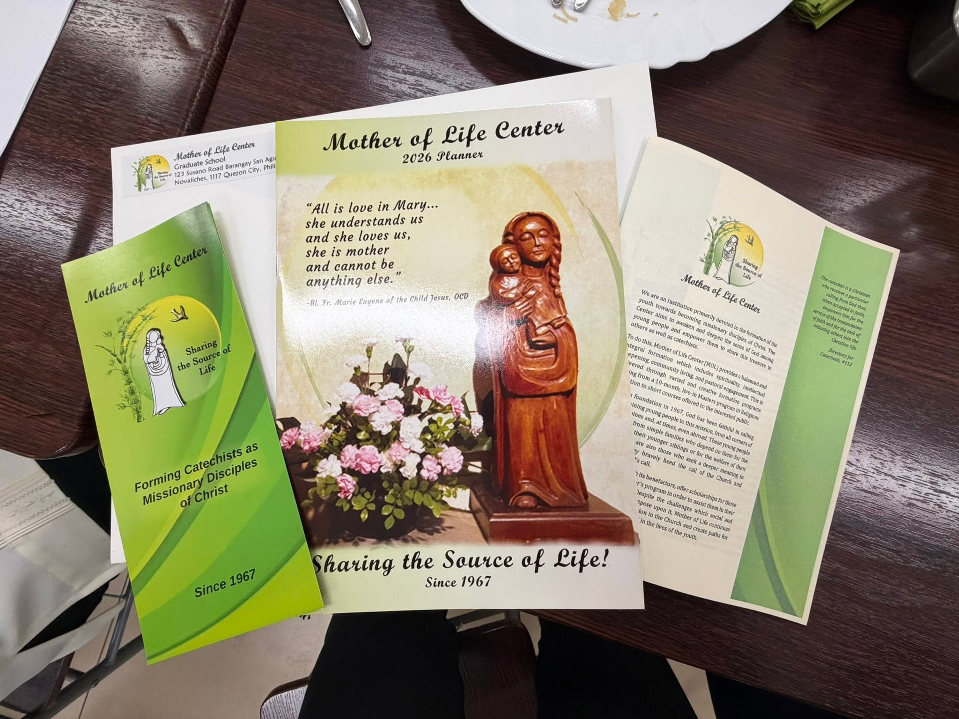

Slide 26
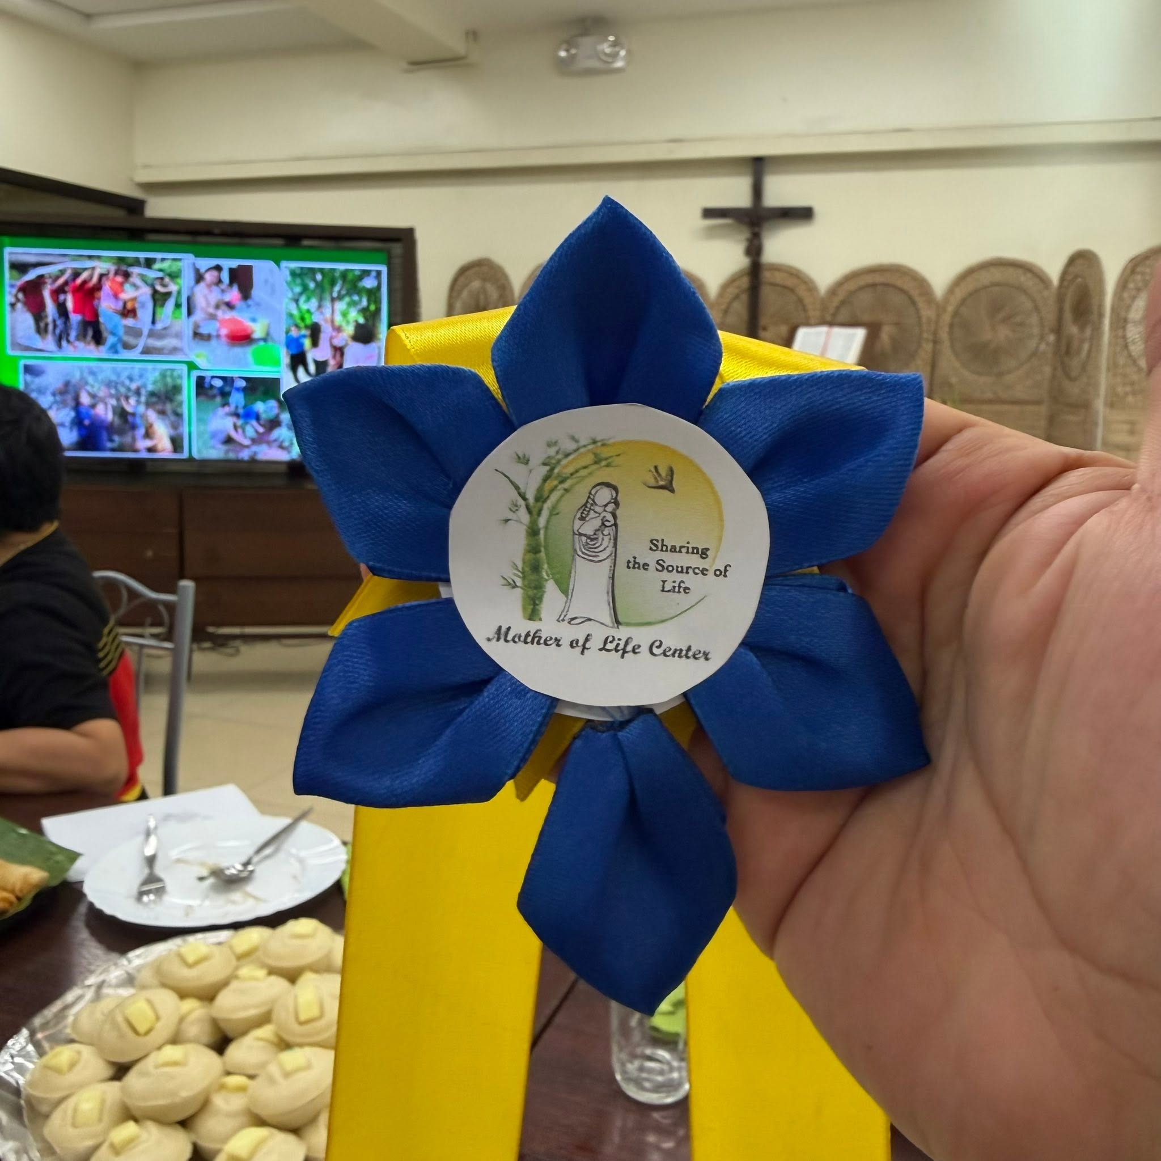

Slide 27
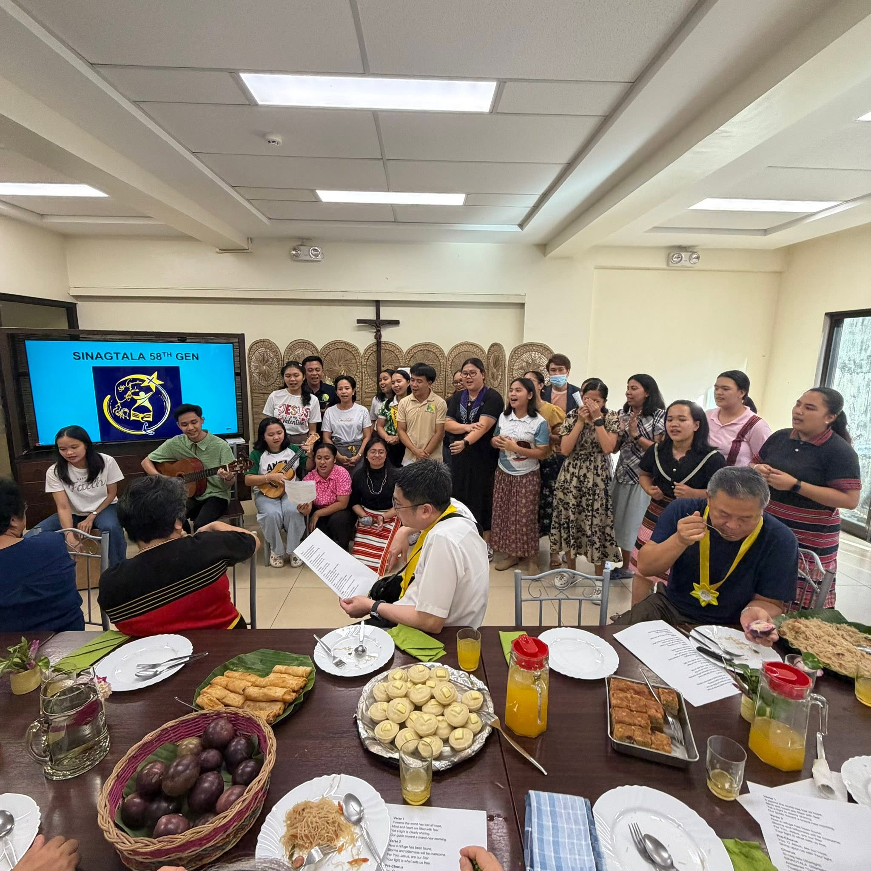

Slide 28
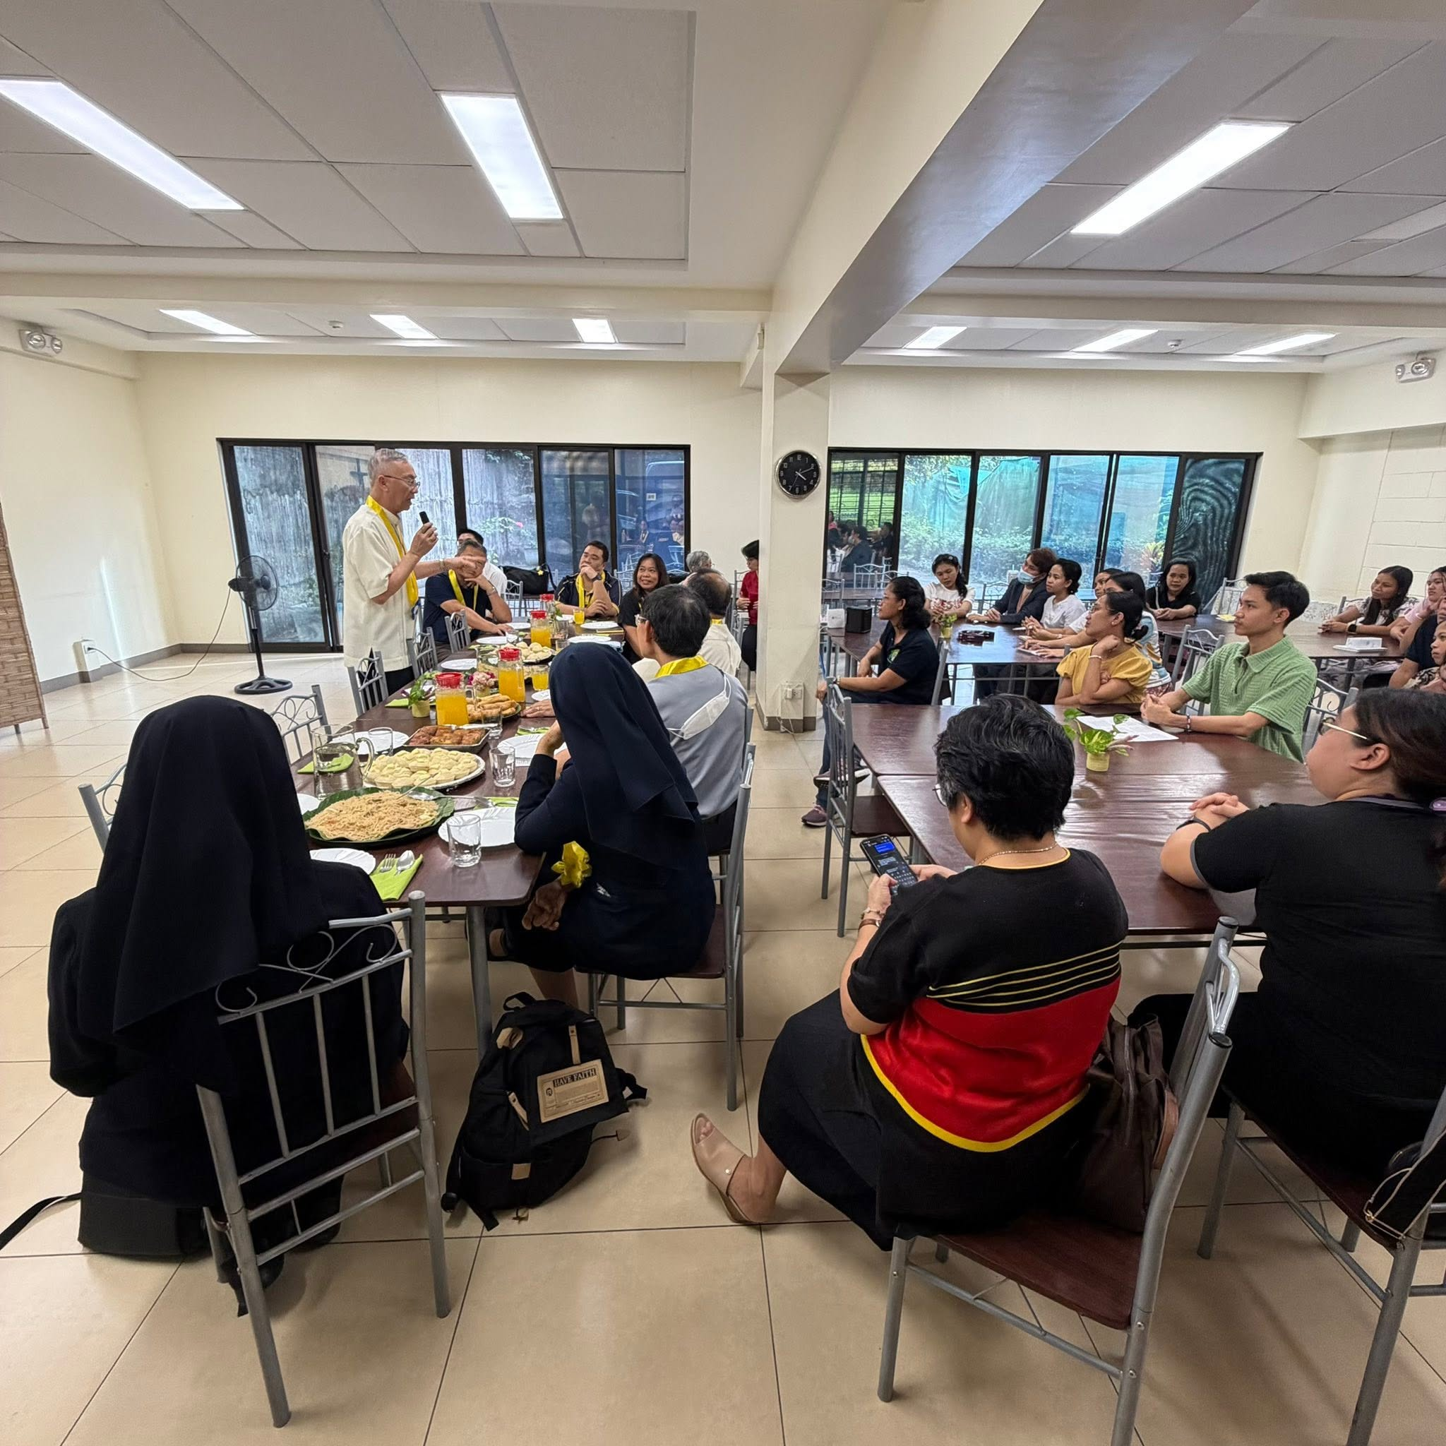

Slide 29
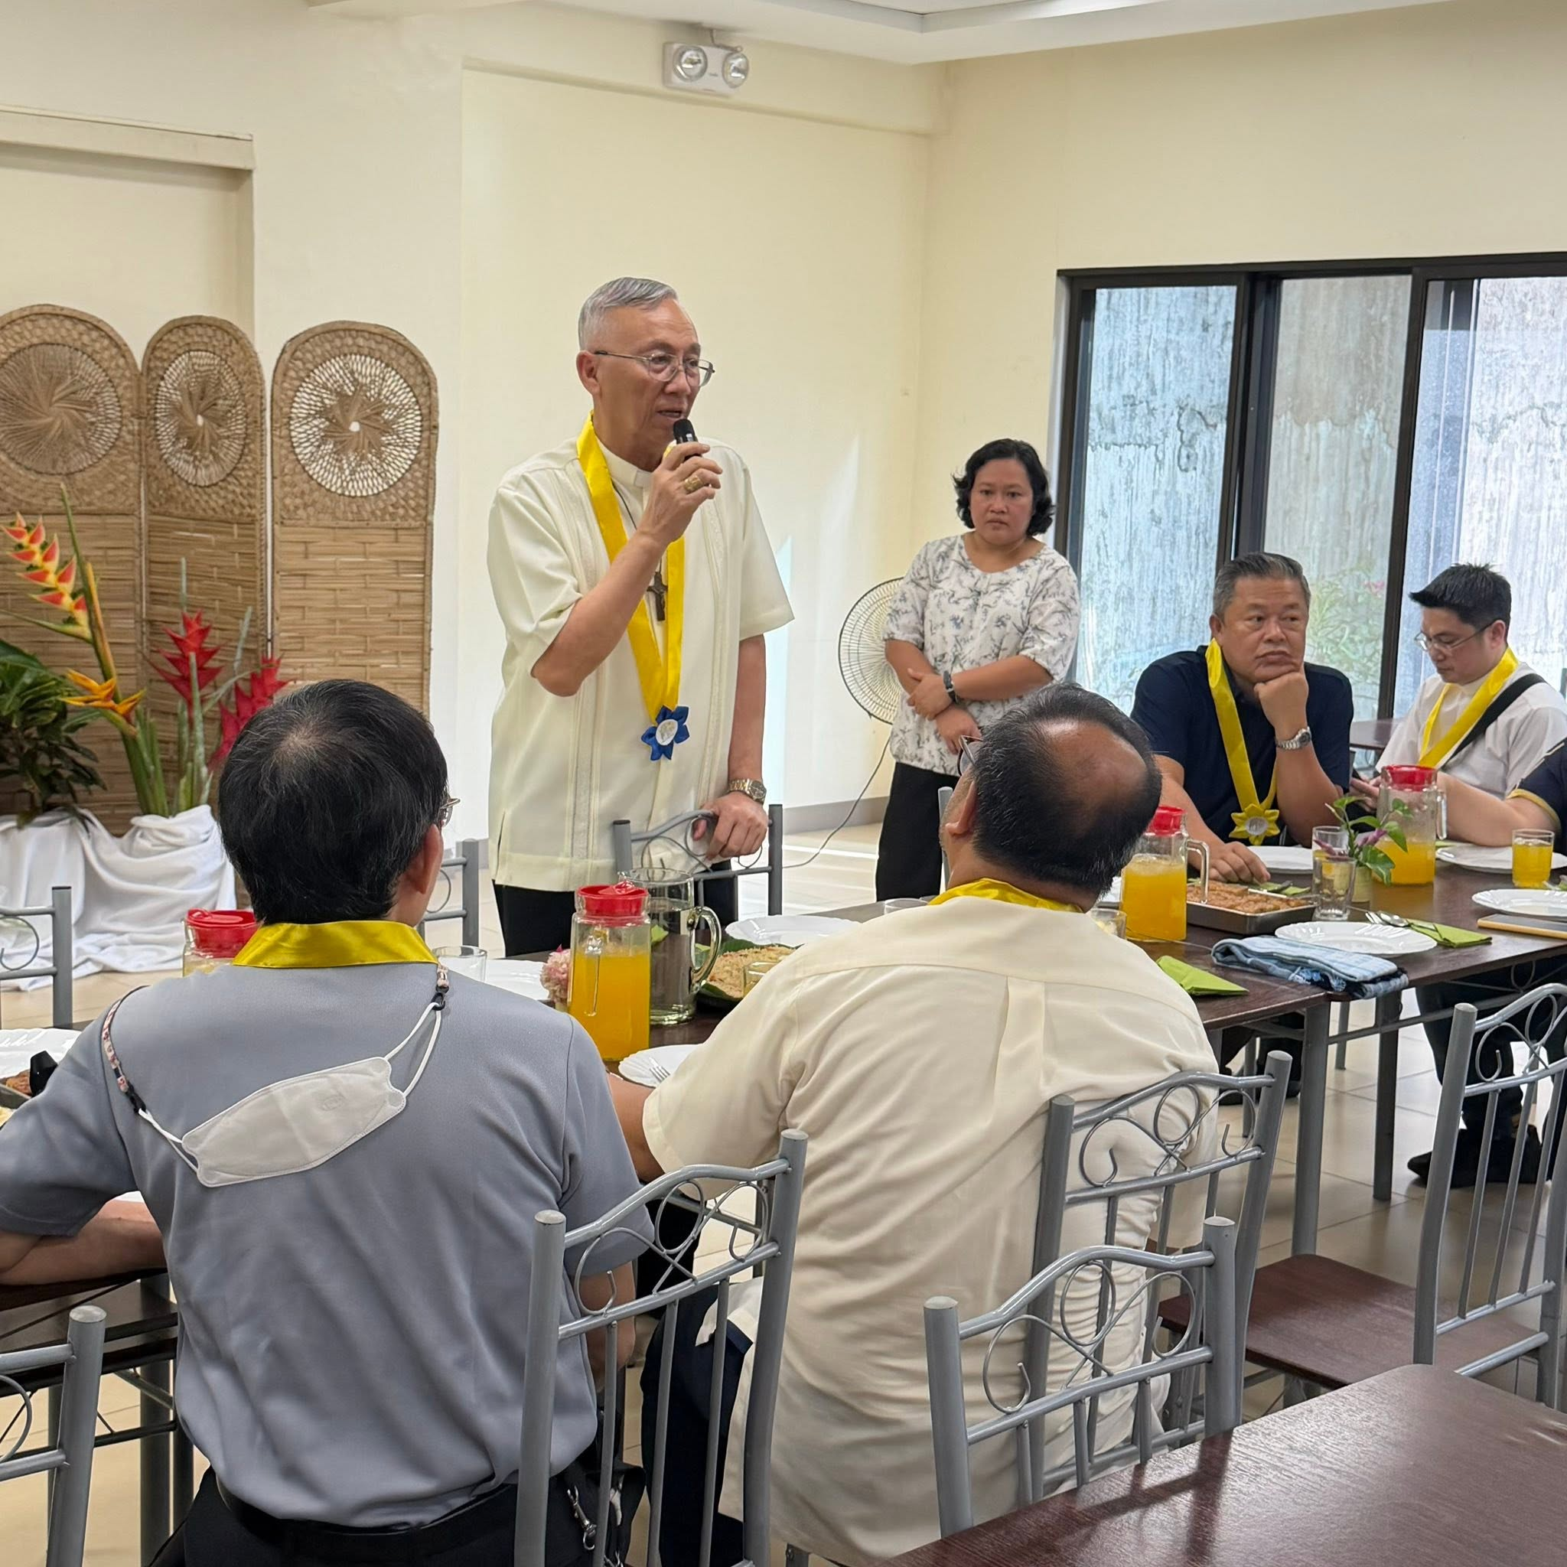

Slide 30
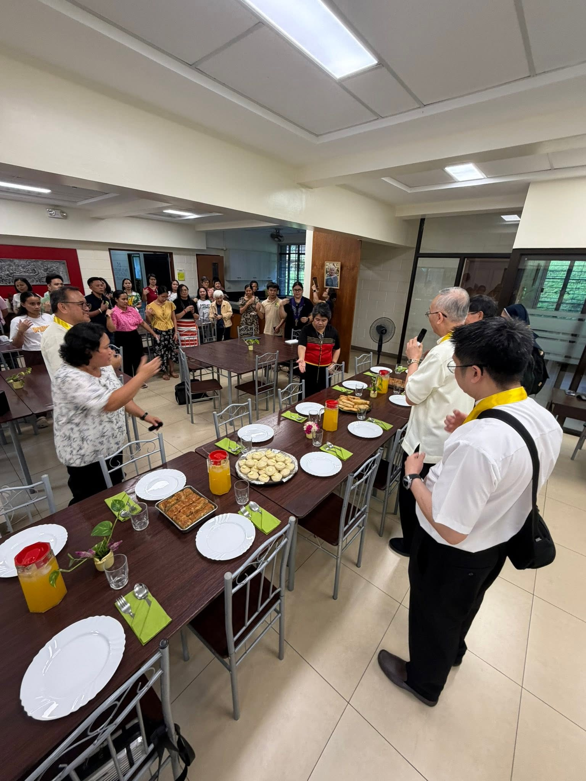

Slide 31
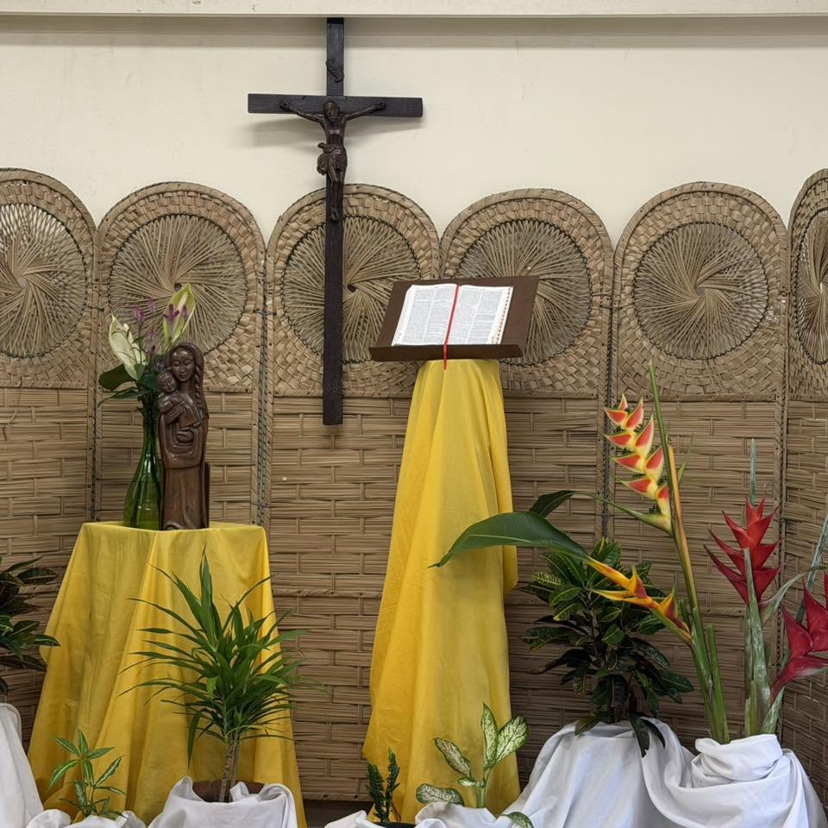

Slide 32
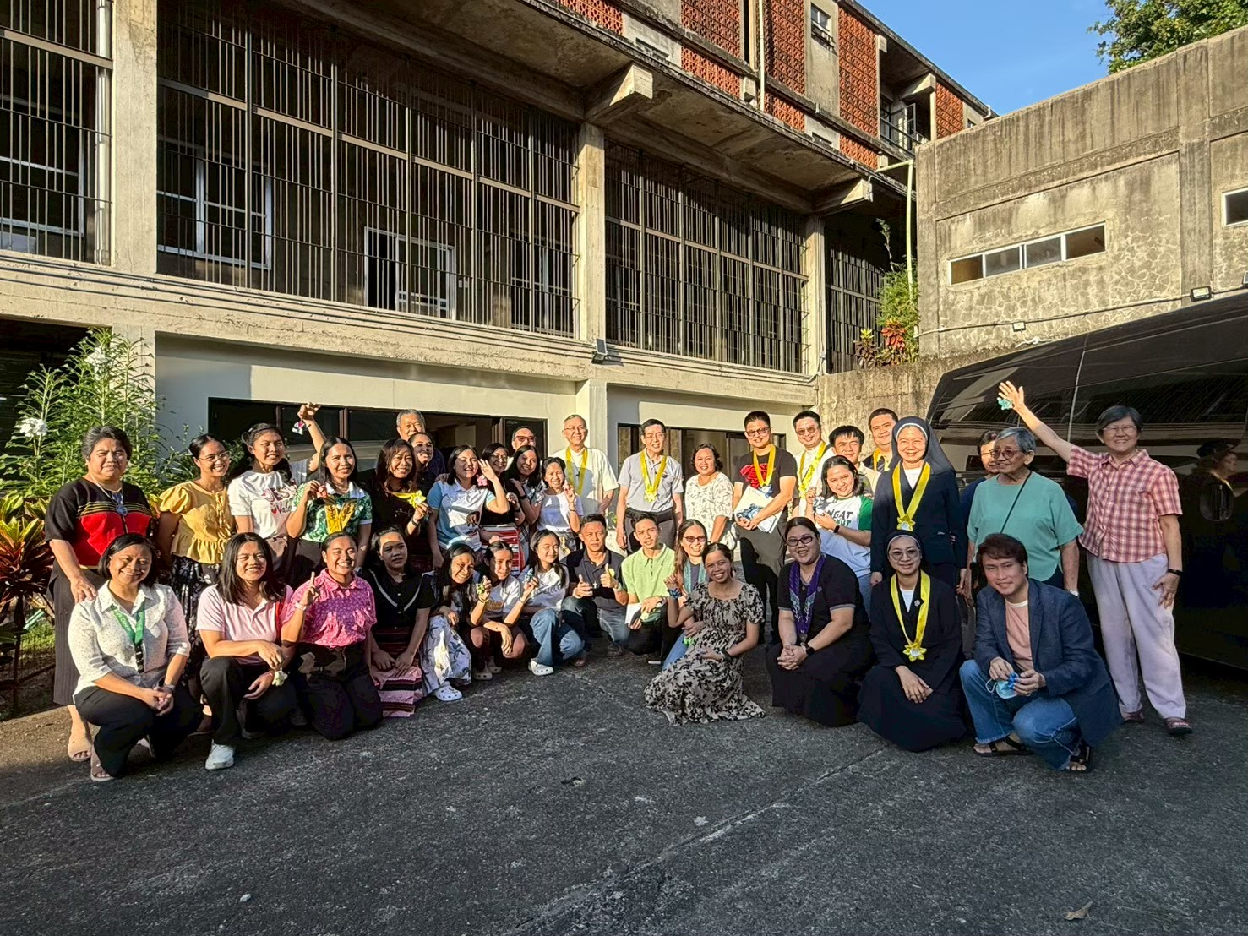

Slide 33
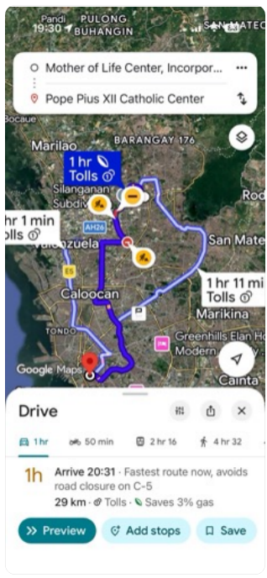
Meeting of Catechetical Leaders
of the Episcopal Conferences of Asia
Pope Pius XII Catholic Center, Manila
11-12 February 2026

Slide 34
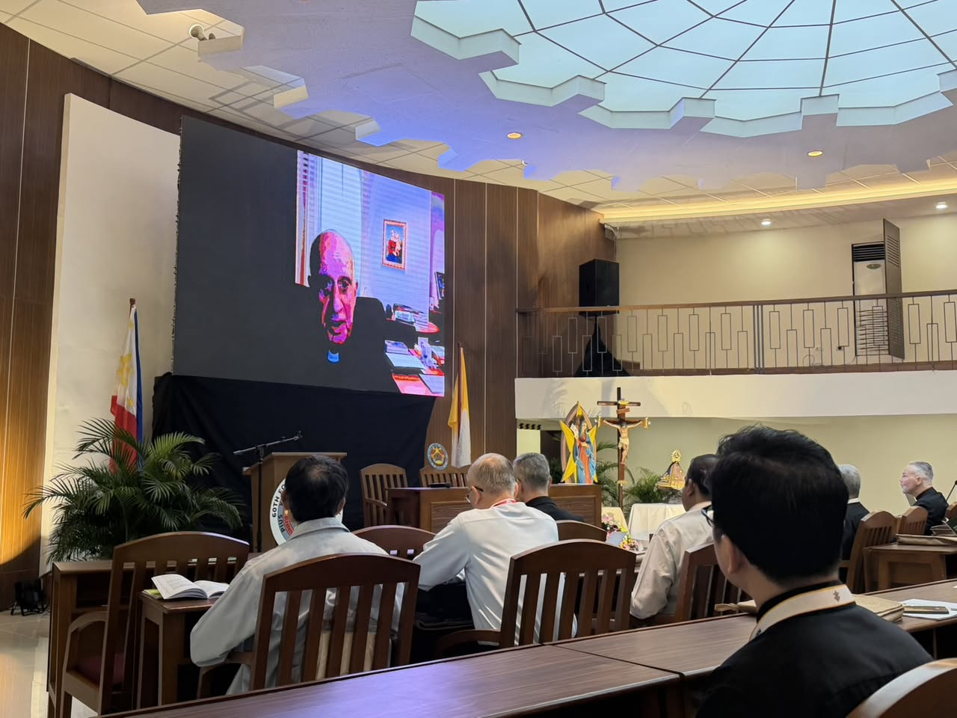
โอวาทของพระคาร์ดินัลรีโน ฟิซิเชลลา (Card. Rino Fisishella) สมณมนตรีสมณสภาเพื่อการประกาศพระวรสาร (Pro-Prefect Dicastery for Evangelization) วันพุธที่ 11 กุมภาพันธ์ 2026 เวลา 08.30 น.

Slide 35
...ขอให้เราได้นึกถึงคู่มือแนะนำด้านการสอนคำสอนที่ออกโดยพระศาสนจักรในปี 1991 และ 1997 ด้วย และนำไปประยุกต์ให้เข้ากับการประกาศพระวรสารในโลกยุคปัจจุบัน ในความหมายหรือความเข้าใจใหม่ในปัจจุบัน จนกลายเป็นอัตลักษณ์ของครูคำสอนในปัจจุบัน ท่ามกลางความท้าทายของโลกยุคปัจจุบัน
เอกลักษณ์ของครูคำสอน หรือหลักในการสอนคำสอน เพื่อให้ทุกคนมีความรู้สึกเป็นเจ้าของและมีส่วนร่วมในชีวิตชุมชนแห่งความเชื่อ ชีวิตหมู่คณะ มีความรับผิดชอบต่อพันธกิจที่ได้รับมอบหมาย
เรารู้ดีว่าการประกาศพระวรสารเป็นธรรมชาติของพระศาสนจักร เกี่ยวข้องกับพระพรที่เราได้รับ (Charism) ในศีลศักดิ์สิทธิ์ต่าง ๆ ท่ามกลางโลกที่กำลังเปลี่ยนแปลง ท้าทายให้เราประกาศพระวรสารด้วยภาษาใหม่ ๆ (เทคโนโลยี) การใช้ช่องทางในการสอนคำสอนอย่างเหมาะสม การปรับให้เข้ากับผู้ฟัง/ผู้เรียนคำสอน โดยยังคงยึดเนื้อหาและความสำคัญเอาไว้...

Slide 36
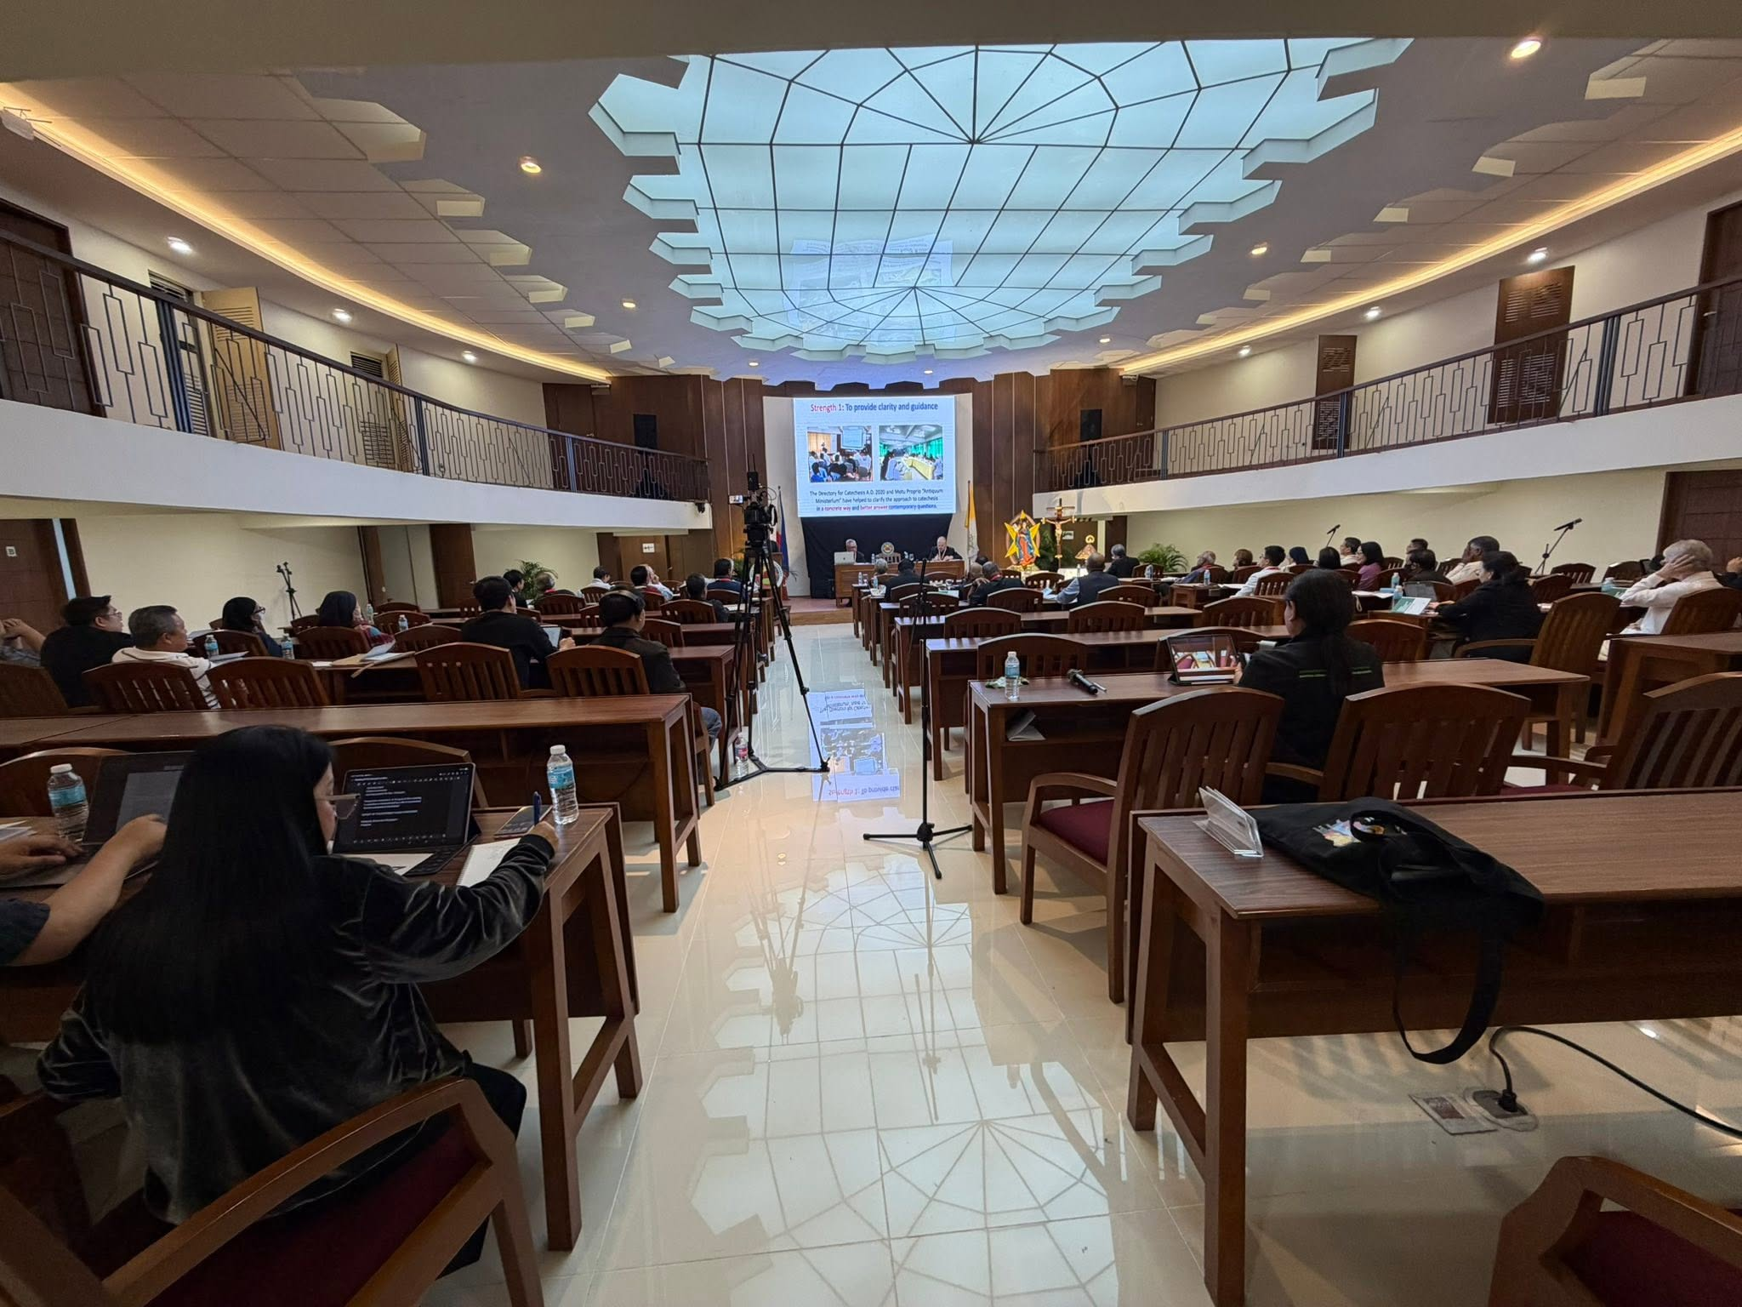

Slide 37
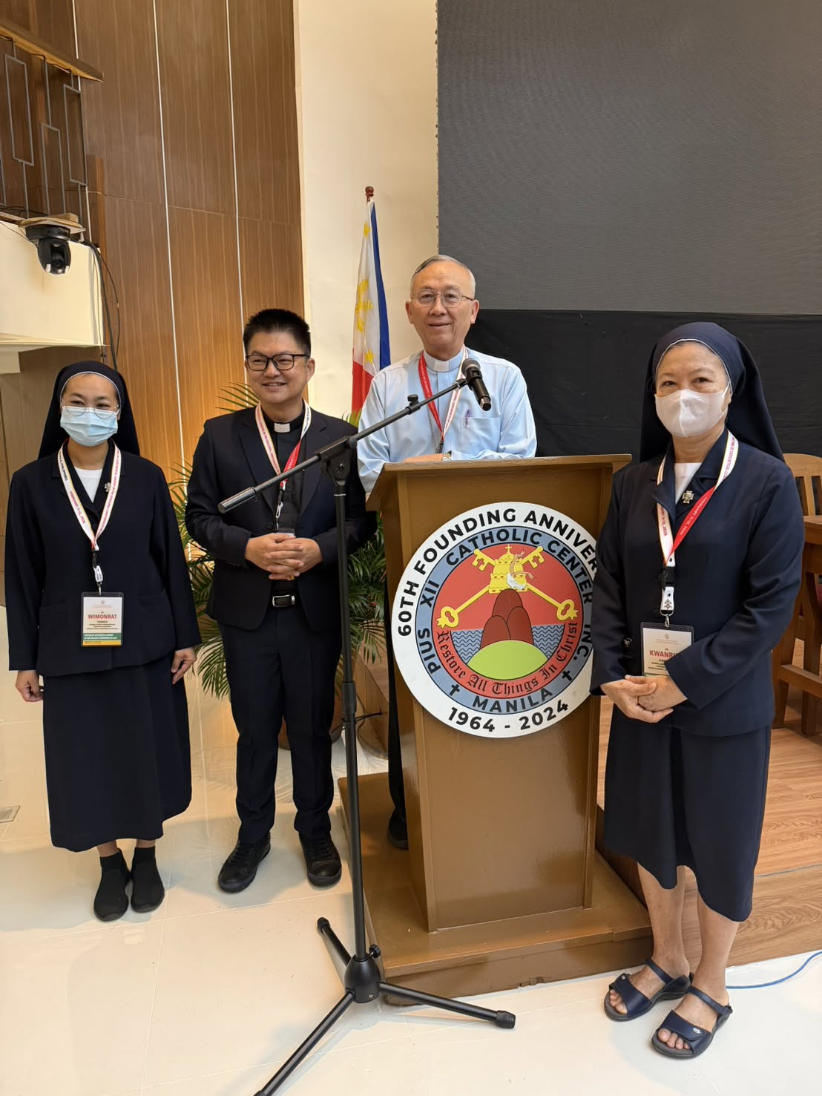

Slide 38
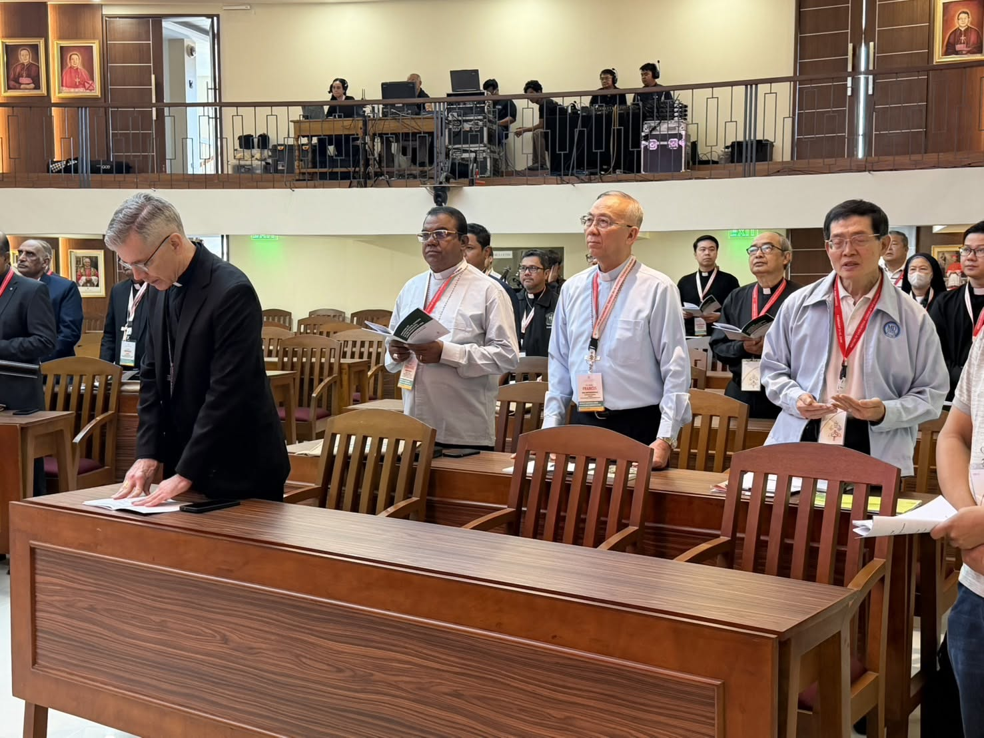

Slide 39
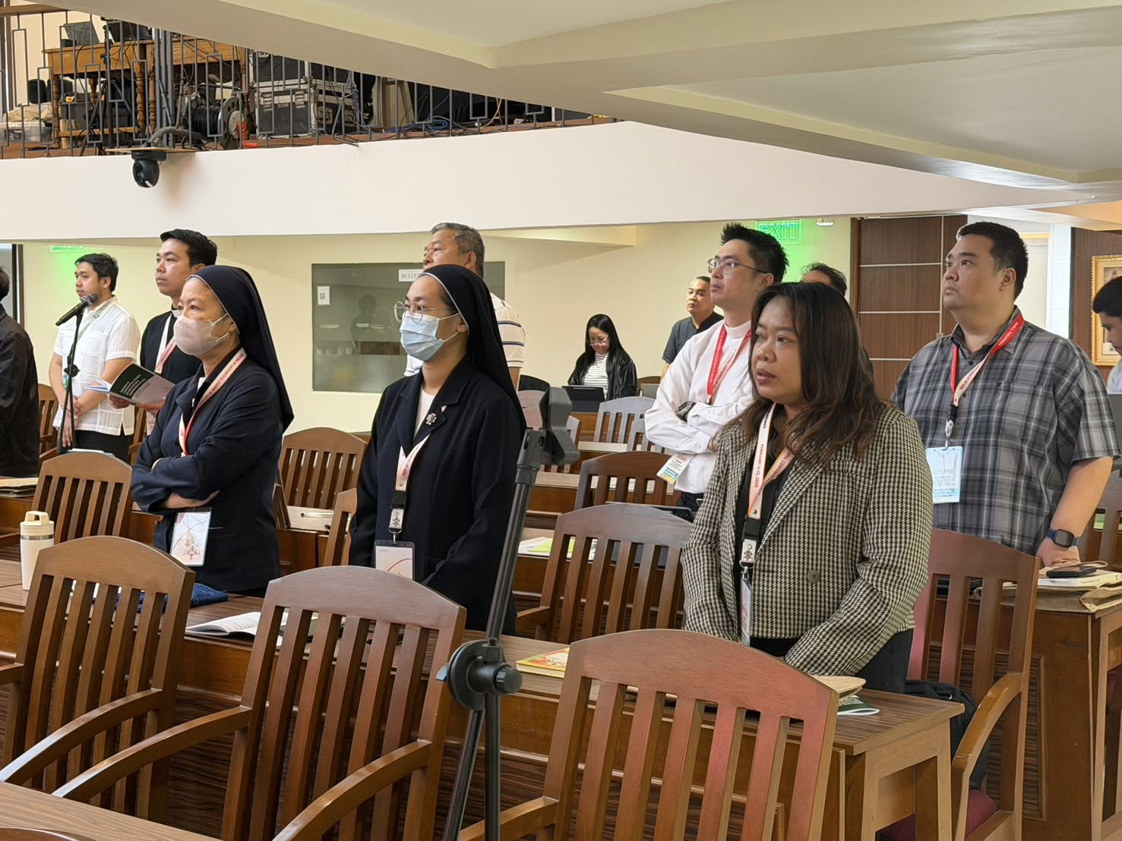

Slide 40
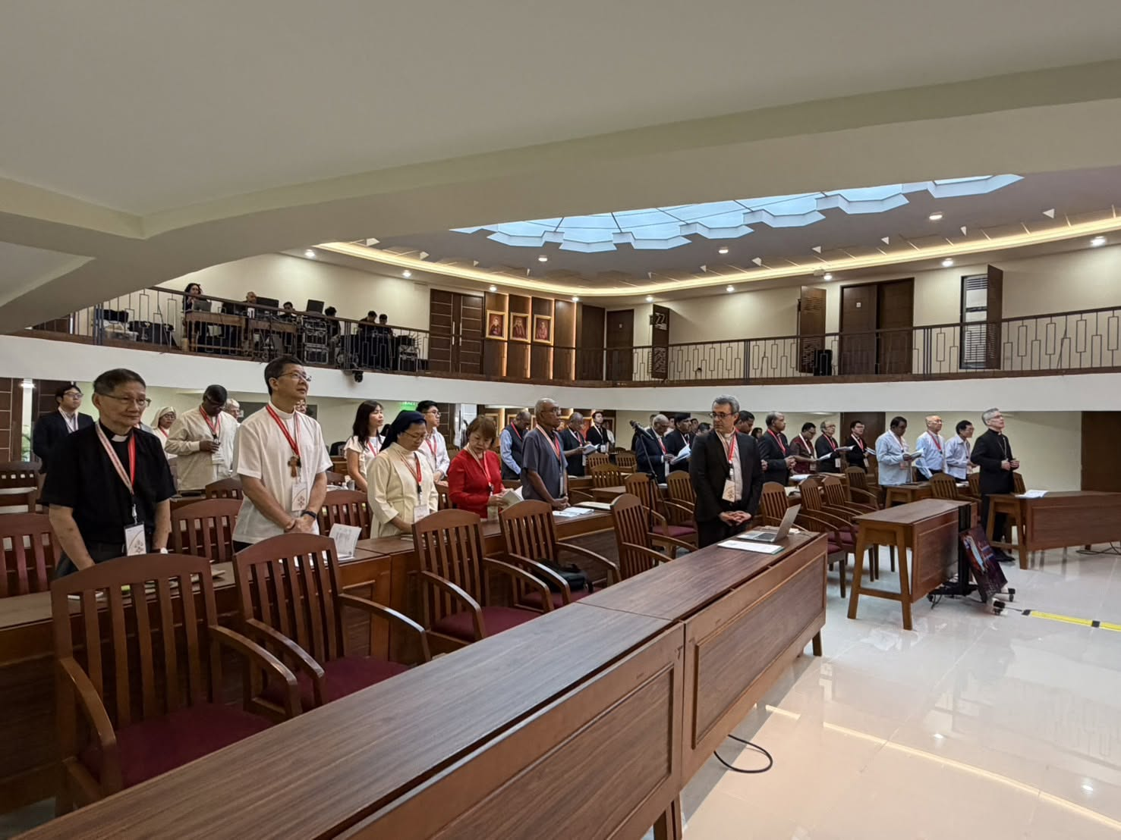

Slide 41
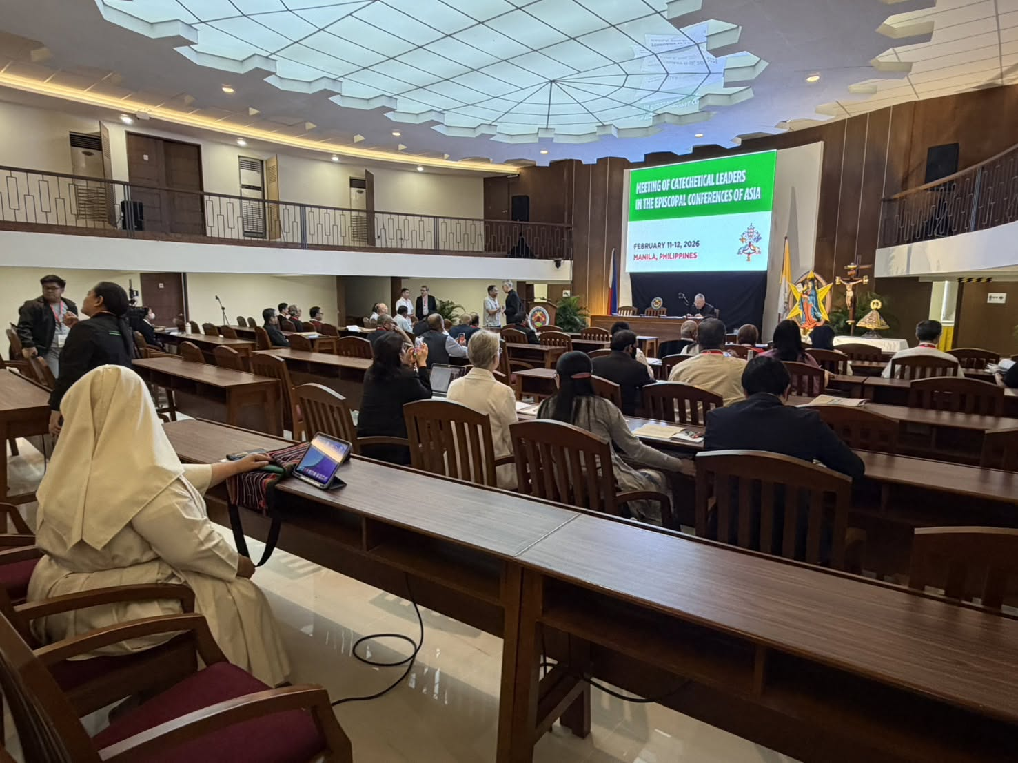

Slide 42
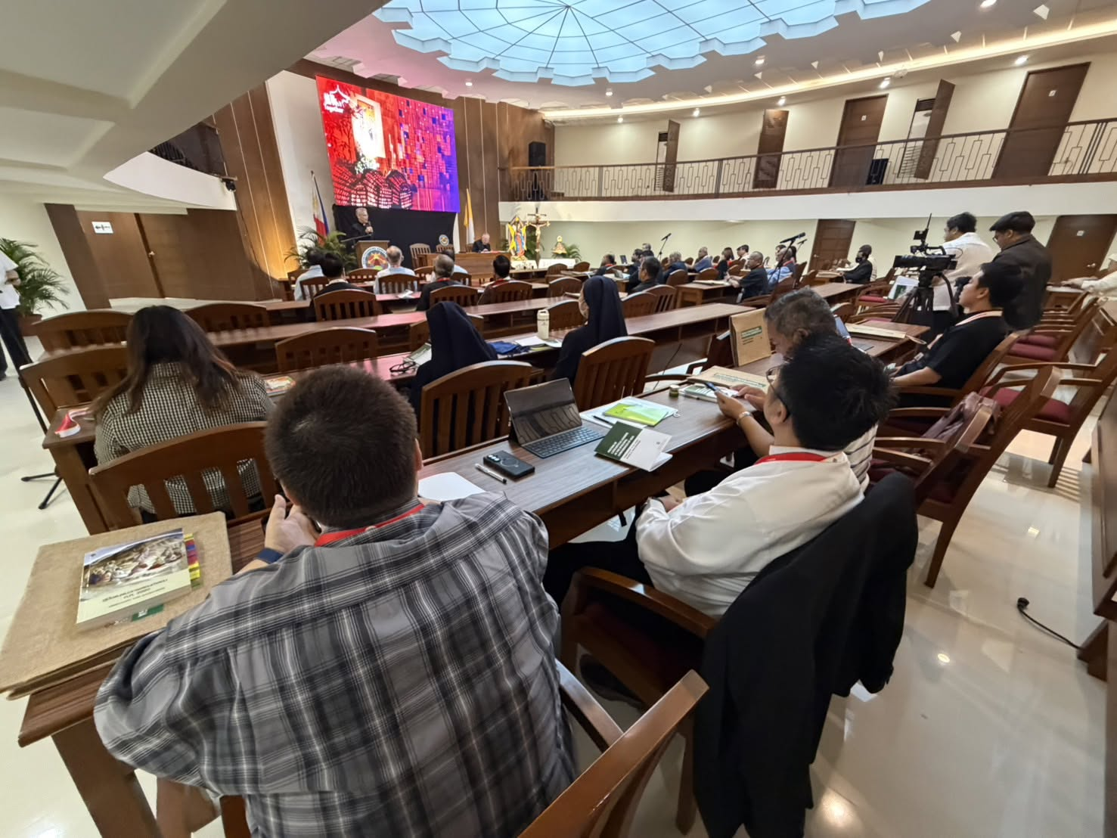

Slide 43
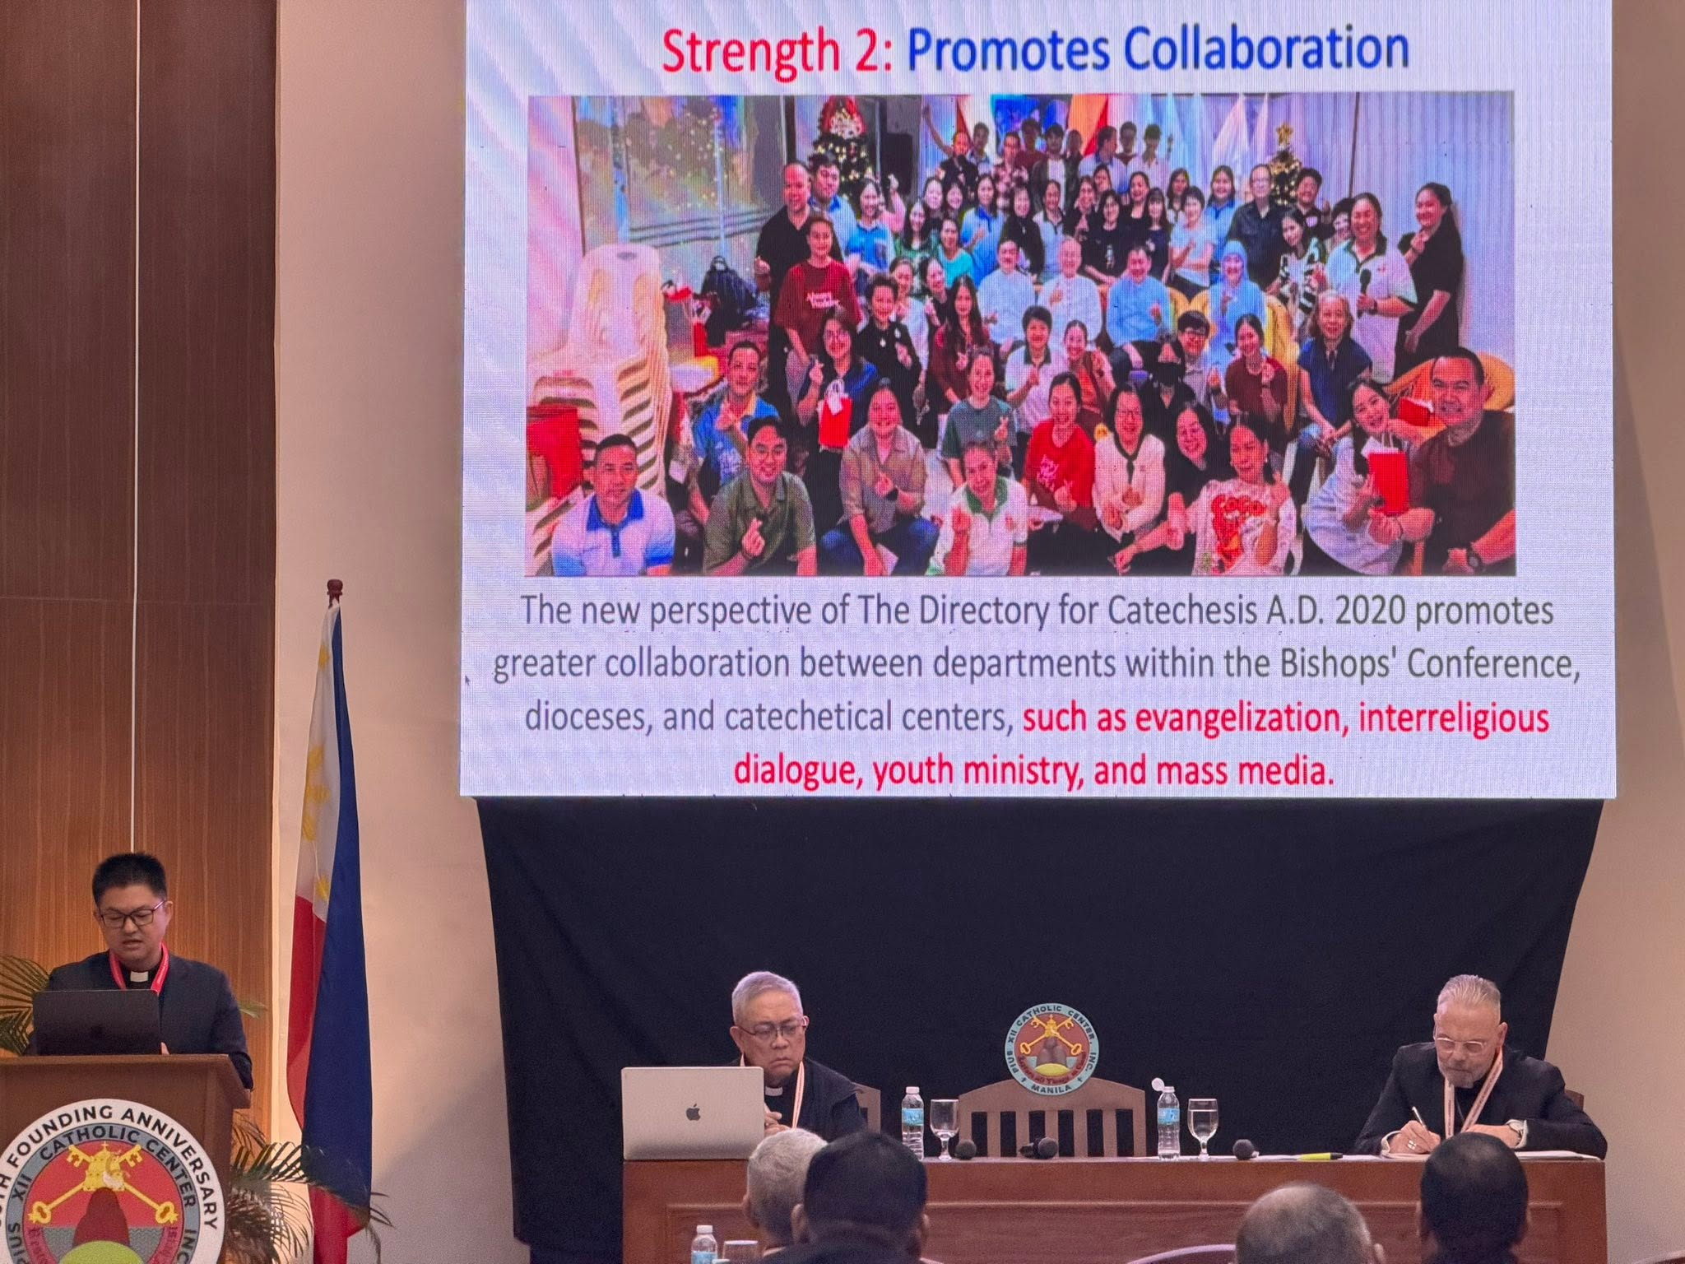

Slide 44
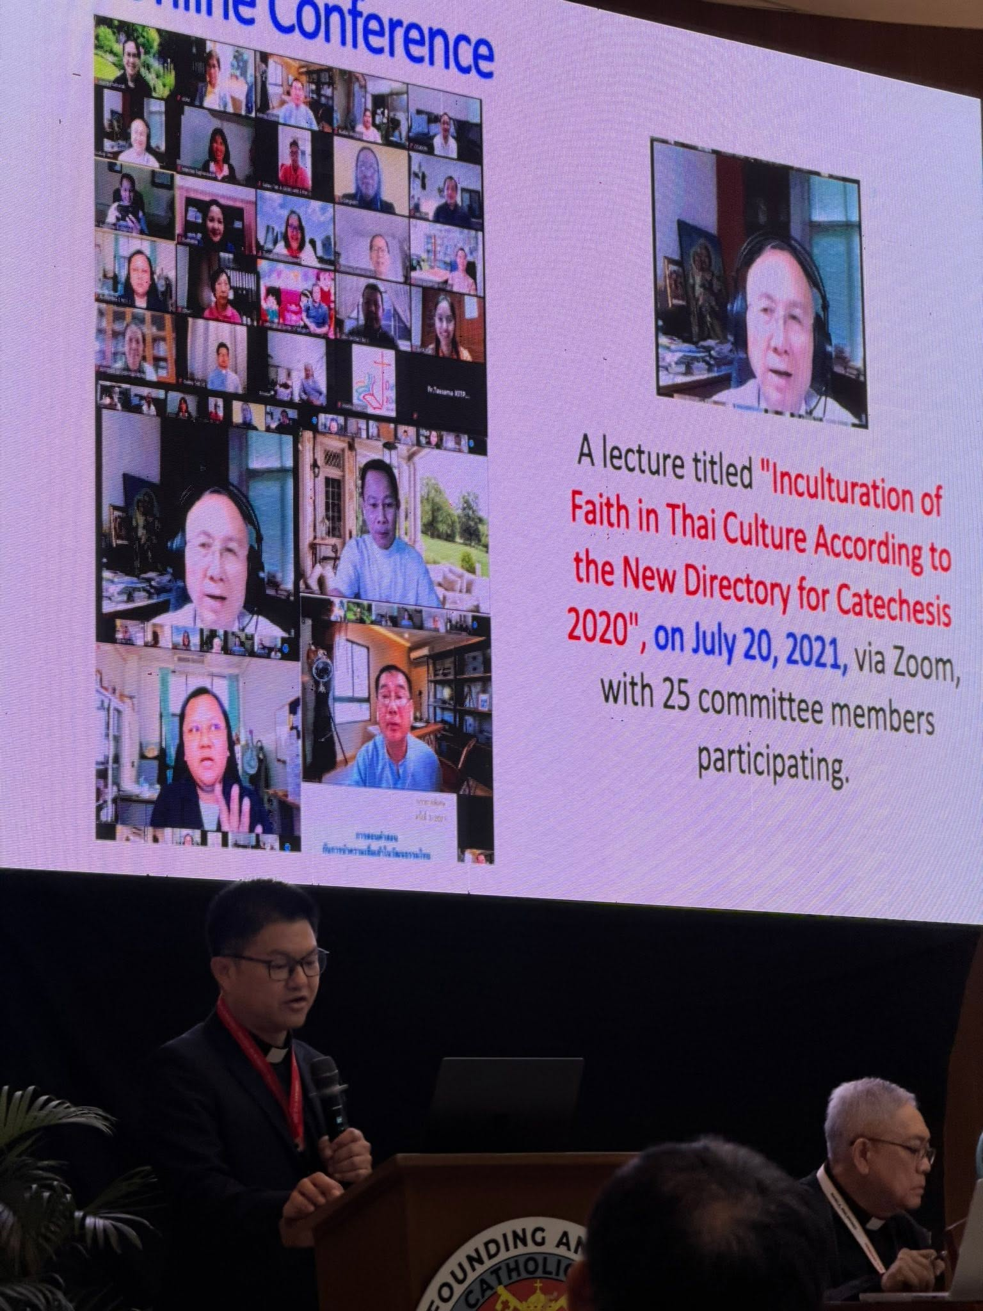

Slide 45
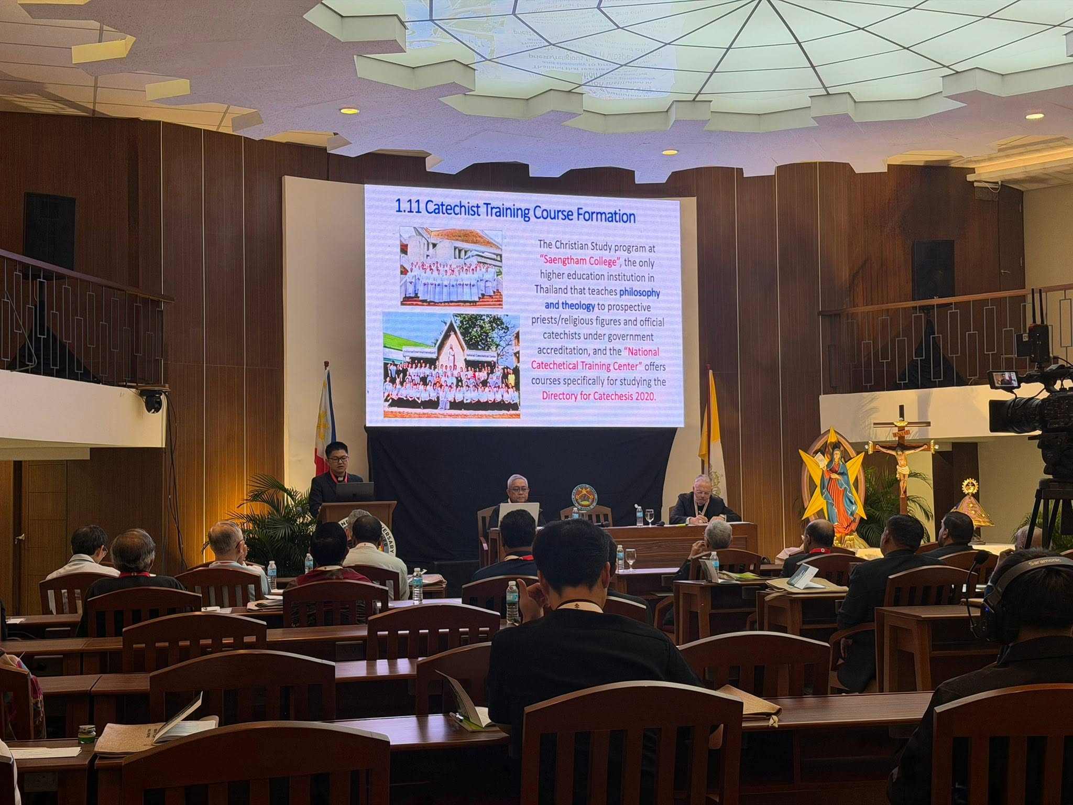

Slide 46
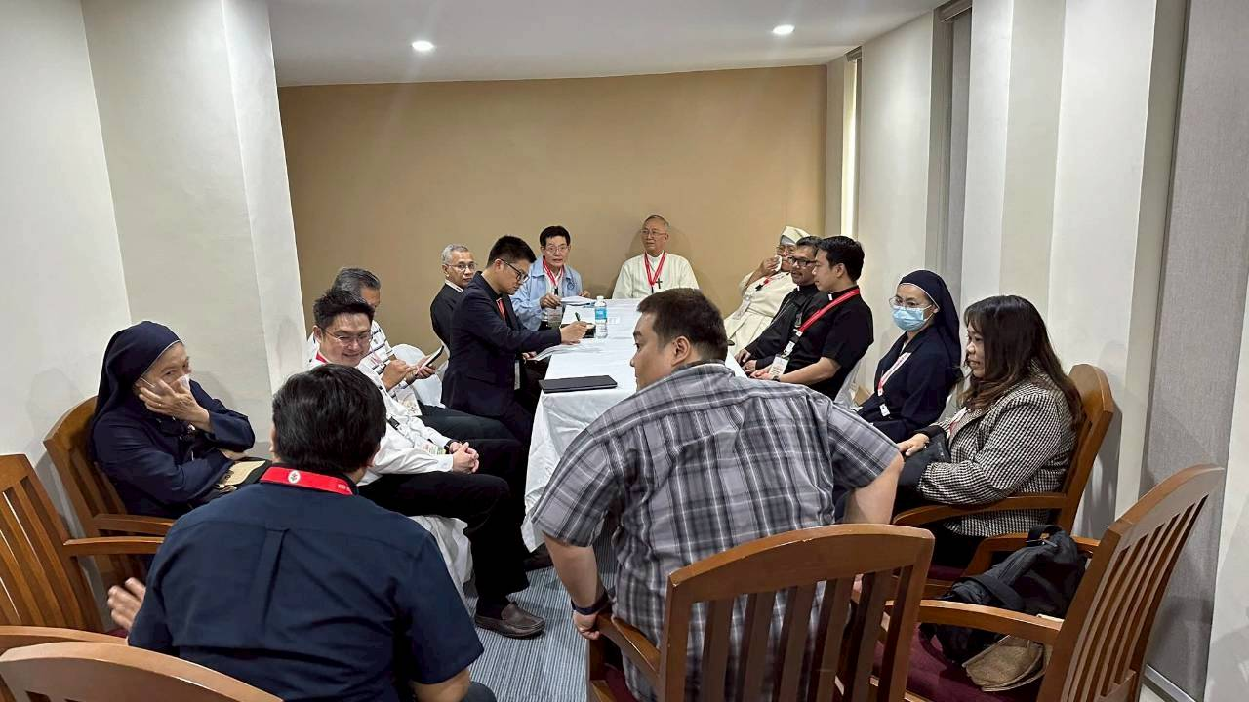

Slide 47
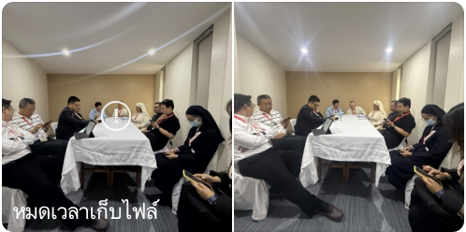

Slide 48
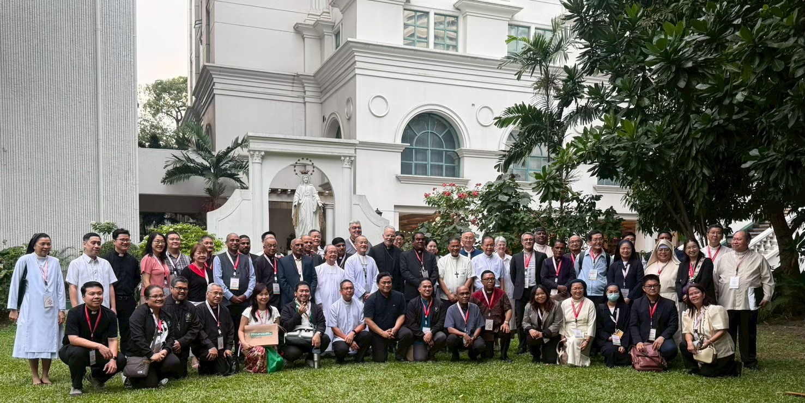

Slide 49
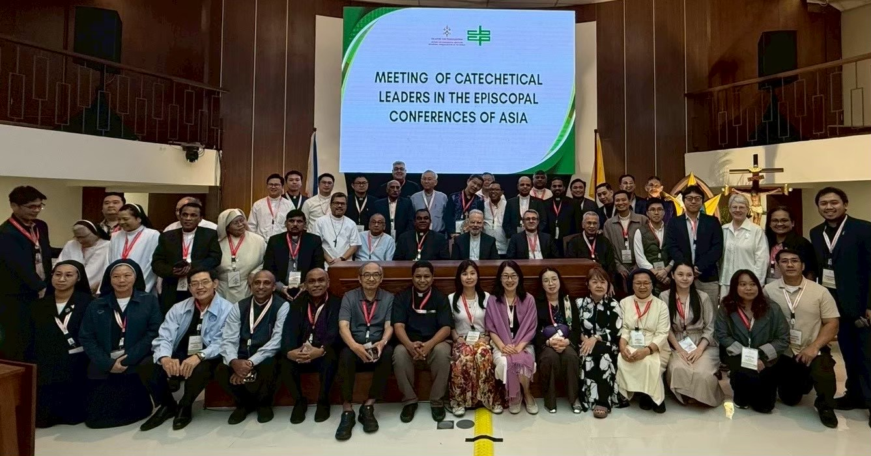

Slide 50


Slide 52

Meeting of Catechetical Leaders of the Episcopal Conferences of Asia,
Manila, 11-12 February 2026
(The image is from the most recent meeting, held on January 21, 2026.)
Report of the Catholic Bishops’ Conference of Thailand on
The Use of “Directory for Catechesis”
and Motu Proprio “Antiquum Ministerium” on the Ministry of Catechist
By the Catholic Commission for Catechetical Education, Desk for Catechesis

Slide 53
How was the Directory of Catechesis received
into your Episcopal Conference?

Slide 54

1.1 Translate into Thai
The Directory for Catechesis 2020 was translated into Thai in July 2020 by the Commission of the Catechetical Department, under the Catholic Bishops’ Conference of Thailand.

Slide 55




Subcommittee for Translation
1. ประภา วีระศิลป์
Prapha Weerasilp
2. ยุพา ชุลีระรักษ์
Yupapha Chulirarak
3. คุณพ่อสมหมาย มธุรสสุวรรณ
Fr. Sommai Mathurotsuwan
4. มงซินญอร์ วิษณุ ธัญญอนันต์
Monsignor Wisanu Thanyanan

Slide 56


1.2 Published online
The Thai edition of The Directory for Catechesis was published online on the official website of the Catholic Commission for Catechetical Education, Desk for Catechesis. www.thaicatechesis.com
https://www.thaicatechesis.com/Document/DIRECTORY_FOR_CATECHESIS/directory_for_catechesis.html

Slide 57


1.3 Search Program according to the Chapters
Develop a search program on the website to facilitate research and study.
https://www.thaicatechesis.com/dc2020/

Slide 58


1.4 Bishop Francis Xavier Vira Arpondratana, author of the “5-Minute Catechism” column in Thailand's Catholic weekly newspaper U-Don-Saan, and on the official website of the Catholic Commission for Catechetical Education, Desk for Catechesis, translated of the statement by Bishop Rino Fisichella introducing The Directory for Catechesis 2020, issued on June 26, 2020.
(https://www.thaicatechesis.com/kamsornhanatee/content170/content170.html)

Slide 59

1.5 Seminar
A Seminar on Thai Catechetical Training Guidelines in 2020 on the topic
"How are Today's Youth Interested in Religion?" on October 27-28, 2020,
at “Baan Phu Waan Pastoral” Center, with 24 participants.

Slide 60

1.5 Training and catechesis
A seminar on " Evangelization in Culture," based on the Directory for Catechesis 2020, was held on November 20, 2020, with 15 participants.

Slide 61

1.7 Catechetical Formation
"Evangelization and Living in Cultures”, based on the Directory for Catechesis 2020, on March 11, 2021, with 35 participants.

Slide 62


1.8 Online Conference
A lecture titled "Inculturation of Faith in Thai Culture According to the New Directory for Catechesis 2020", on July 20, 2021, via Zoom, with 25 committee members participating.

Slide 63

1.9 Catechists Formation
A lecture titled
"Catechesis and Inculturation of Faith in Thai Culture According to the New Directory for Catechesis" (DC 394-400)
by two speakers:
1) Archbishop Vira Arpondratana
and 2) Bishop Chusak Sirisut, Chairman of the Commission for Ecumenical and Interreligious Affairs, on October 7, 2021, via Zoom and Live broadcast on Facebook, with a total of 557.

Slide 64

1.10 Rome Catechist Alumni Meeting
Rome Catechist Alumni Committee organized "A Lecture on the Directory for Catechesis 2020" at the 6th Rome Catechist Alumni Meeting
on December 18, 2021, via Zoom, with 14 alumni participating.

Slide 65


1.11 Catechist Training Course Formation
The Christian Study program at “Saengtham College”, the only higher education institution in Thailand that teaches philosophy and theology to prospective priests/religious figures and official catechists under government accreditation, and the “National Catechetical Training Center” offers courses specifically for studying the Directory for Catechesis 2020.

Slide 66


Slide 67

2. How was Antiquum Ministerium received
and how is it applied?

Slide 68

2.1 Translated into Thai
The Thai translation of Motu Proprio “Antiquum Ministerium”
was completed on May 19, 2021.

Slide 69



2.2 Published on the website.
https://www.thaicatechesis.com/Document/Motu_Proprio__Antiquum_Ministerium.pdf

Slide 70

2.3 Study and Discussion
On July 22, 2022, Catholic Commission for Catechetical Education,
Desk for Catechesis organized a study and discussion
on Motu Proprio “Antiquum Ministerium”.

Slide 71








2.4 Translated the Rite of Institution of Catechists into Thai
After the Congregation for Divine Worship and the Discipline of the Sacraments published the Rite of Institution of Catechists on December 13, 2021, a Thai translation was released on December 16, 2021 (completed within 3 days) and came into immediate use.

Slide 72


2.5 Guidelines for the Appointment of Catechists
The Catholic Bishops’ Conference of Thailand issued “Guidelines Regarding the Appointment of Catechists” on March 22, 2023, which includes:
1. Historical Background
2. Importance and Necessity
3. Definition
4. Qualifications
5. Role of the Bishop
6. Appointment Guidelines of the Catechists

Slide 73

3. Strengths and Struggles in implementing:
The Directory for Catechesis A.D. 2020 and
Motu Proprio “Antiquum Ministerium”.

Slide 74


Strength 1: To provide clarity and guidance
The Directory for Catechesis A.D. 2020 and Motu Proprio “Antiquum Ministerium” have helped to clarify the approach to catechesis
in a concrete way and better answer contemporary questions.

Slide 75

Strength 2: Promotes Collaboration
The new perspective of The Directory for Catechesis A.D. 2020 promotes greater collaboration between departments within the Bishops' Conference, dioceses, and catechetical centers, such as evangelization, interreligious dialogue, youth ministry, and mass media.

Slide 76

Strength 3: Appointing of Lay Catechists
Raising awareness within the Catholic Church in Thailand about the importance of formally appointing lay catechists.

Slide 77

Strength 4: A Source of Pride
It is a source of pride for lay catechists that the Church
cares for, honors, and officially welcomes them.

Slide 78

Struggle 1: A Source of Pride
A lay catechist who may not have much formal education but has good Christian life, experience, and serves as a good example. They have limited access to and understanding of official Church documents, even though catechetical centers provide knowledge and understanding through periodic training.

Slide 79


Struggle 2: Increased Responsibilities and Works
To the general understanding of laypeople, especially local catechists, formal appointment means
demanding increased responsibilities and works.

Slide 80


Struggle 3: Perspectives
There are few lay catechists who have received formal training in catechetical education (college or National Catechetical Center), making it increasingly necessary to rely on local catechists. This, however, makes it more difficult to introduce new perspectives on catechesis.

Slide 81


Struggle 4: Using of Technology
Most of the local catechists,
who are the primary catechesis in rural churches,
are not digital natives, which slows down the a new way of catechesis.

Slide 82





THANK YOU

